Slide 1

第４回
教科探究プログラム
（
1年 英語
講師:仲西 真由
麻生 朋成
R7.12.20（土）
大分県教育センター

Slide 2

What do you want for Christmas？

Slide 3

８

Slide 4
16

Slide 5
17

Slide 6
Today’s Goal!!
読むことと聞くことを通して、
物語の情景や登場人物の心情を理解し、
登場人物の会話を想像して、
ロールプレイの中で英語で表現する
ことができる。

Slide 7
Today’s plan!!
Warm-up (the 1st paragraph)
2. Reading 1 (the 2nd paragraph ~ the 5th paragraph)
3. Reading 2 (the 6th paragraph ~ the 8th paragraph)
〜 Break 〜
4. Skit Making
5. Role Play
6. Reflection

Slide 8
Warm up!!
Please imagine the story
with some key words.

Slide 9
Warm up!!
It’ s
1914. t
he British and German u. sh military
nervous, sn enemy ay attack ur
Christmas or
New Year.

Slide 10
Warm up!!
It is Christmas Eve—December 24, 1914. The night is cold and quiet, and the snow shines under the moon. British and German soldiers are in trenches near a small town in northern France. The British military is nervous, because the enemy may attack during Christmas or New Year. The officers send a message to the front line: “Be careful. The enemy may attack during Christmas or New Year.”

Slide 11
Warm up!!
It is Christmas Eve—December 24, 1914. The night is cold and quiet, and the snow shines under the moon. British and German soldiers are in trenches near a small town in northern France. The British military is nervous, because the enemy may attack during Christmas or New Year. The officers send a message to the front line: “Be careful. The enemy may attack during Christmas or New Year.”
Please answer
５W1H Questions
Who? What? Where? When? Why？How?

Slide 12
Warm up!!
How to answer 5W1H Questions
Who?→ Many high school students
What?→ are studying English
Where?→ at Oita Prefectural Education Center
When?→ on December 20, 2025
Why?→ English workshop
How?→ They are guessing what kind of story
it is.

Slide 13
Warm up!!
Who?→ British and German military
What?→ are fighting Not written in the text
Where?→in a small town in northern France
When?→ on December 24, 1914
Why?→ War (World WarⅠ) Not written
How?→ British military command
is feeling nervous
because the enemy may attack
during Christmas or New Year.

Slide 14
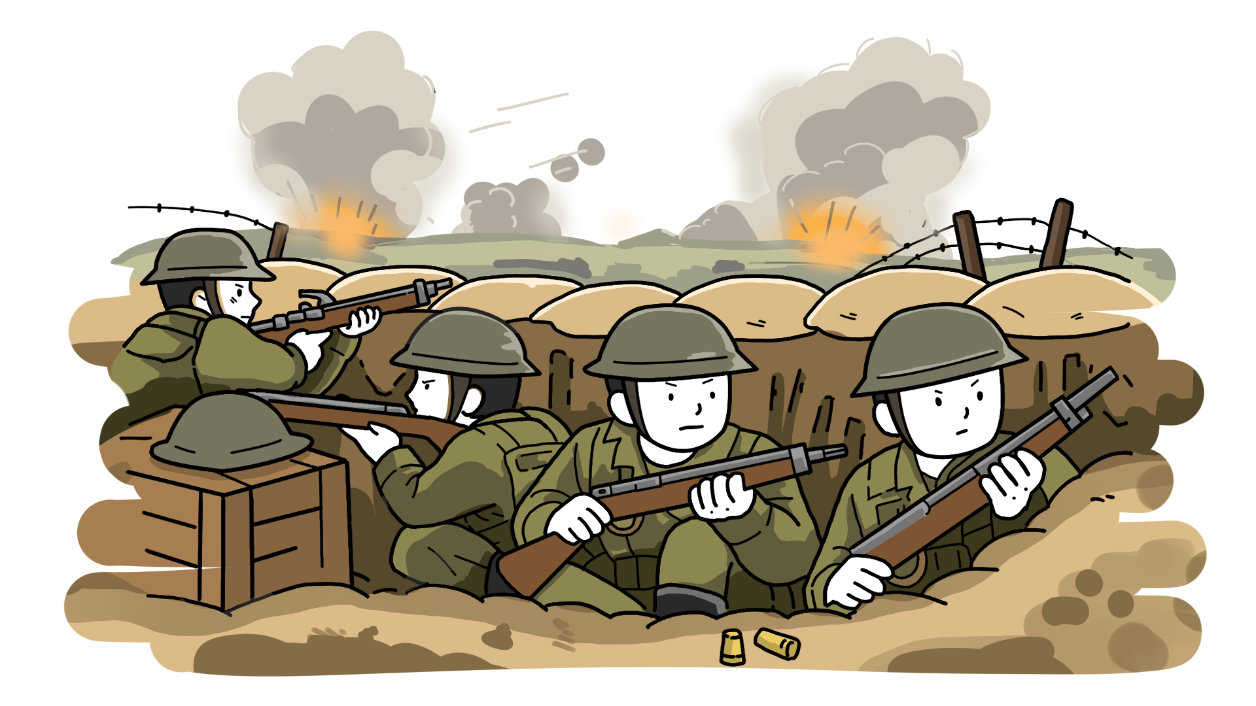
Warm up!!
trenches

Slide 15
Reading 1
MetaMoji
Q2. 第 〜 段落を読んで、内容を2枚の絵に描きなさい。
（第 段落の絵 、第 段落の絵）
1枚 1枚 ☆ペアで分担してもOK
2
５
2
3
４
５

Slide 16



Reading 1
Light flickers on

Slide 17
Reading 1
Light flickers on
Flicker
Flash

Slide 18
Reading 1
Question:
If you were in his position,
would you go into the field between both armies?
Why? / Why not?

Slide 19
Let’s watch & listen?

Slide 20
Reading 2
MetaMoji
Q3. 第 〜 段落を読んで、内容を2枚の絵(2つの場面)
に描きなさい。 ☆ペアで分担してもOK
６
８

Slide 21
Reading 2
They exchange small gifts. The British share chocolate, tea, and cakes. The Germans share cigars, sauerkraut, and schnapps.
sauerkraut, schnappsとは？？

Slide 22
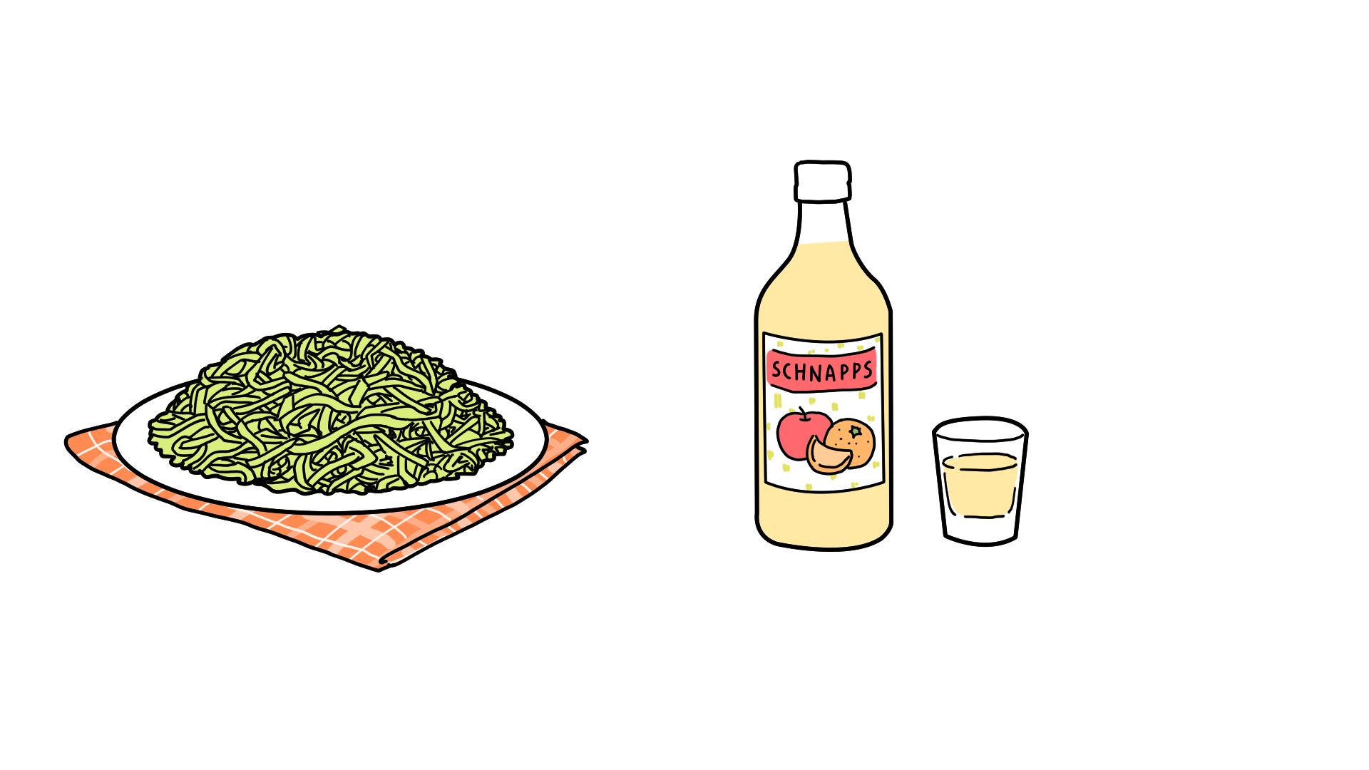
Reading 2
Sauerkraut
Schnapps

Slide 23
Let’s watch & listen?

Slide 24


Take a Break!!
Take a break for 10 minutes.
If you haven’t finished drawing the picture, please finish it up.

Slide 25
Today’s Goal!!
読むことと聞くことを通して、
物語の情景や登場人物の心情を理解し、
登場人物の会話を想像して、
ロールプレイの中で英語で表現する
ことができる。

Slide 26
Make a Skit!!
Work Sheet
Imagine the conversation
between a British soldier and a German soldier at the party.
場面設定（ナレーション）British soldierとGerman soldierの会話を想像して、どのような言葉が交わされたのか、Skit（寸劇）の原稿を考える。
合計３分程度
○１分（作成した絵を使ってナレーション）
－これまでの場面を踏まえたナレーション（２人）
○１分半（兵士たちの会話）

Slide 27
Make a Skit!!
On Christmas Eve, 1914
Narrators
Picture１（1～5 paragraph）
Picture２ (6～8 paragraph)
The next morning, Christmas day
That evening, they held parties up and down the lines.
What were they talking about during the party?

Slide 28
Role Play!!
Desk
Narrator① | British soldier
Narrator② | German soldier

Slide 29
Role Play!!
Work Sheet
Imagine the conversation
between a British soldier and a German soldier at the party.
Narrator（2名)・British soldier・German soldier
配役を決定後、skitの作成を行ってください。
Skit(Narration)作成： | 12分
練習： | ８分
各班の発表： | ３分程度

Slide 30
Role Play!!
Work Sheet
Imagine the conversation
between a British soldier and a German soldier at the party.
Example
family
home town
after the war

Slide 31
Role Play!!
～listeners～
After the role play, please tell the best point of the group in Japanese. (1min）
Example
・会話の内容
・ナレーションの分かりやすさ
・使っていた英語について（量、表現の豊かさ等）

Slide 32
Role Play!!
Role play①
Show your role play (3min)
Listeners
Tell the best point of the group in Japanese after the role play. (1min)

Slide 33
Role Play!!
Role play②
Show your role play (3min)
Listeners
Tell the best point of the group in Japanese after the role play. (1min)

Slide 34
Role Play!!
Metamoji
Question
How did the soldiers feel during the party?

Slide 35
Role Play!!
Metamoji
Share your opinions in a group(2min)

Slide 36
The Final Question!!
Metamoji
Question
What title would you give this story?

Slide 37
The Final Question!!
For many years, people doubted the Christmas truce of 1914 and called it just a touching story. After the holidays, the fighting started again, and millions more died, so the truce sounded unbelievable. But later, interviews with soldiers who were there showed that the truce was real: over 100,000 men truly stopped fighting and put down their weapons that day.
Work Sheet

Slide 38
The Final Question!!
Work Sheet
”Christmas truce”
和訳を考えてみよう。

Slide 39
The Final Question!!
Work Sheet
”Christmas truce”
クリスマス休戦

Slide 40
Reflection!!
本日の講義の振り返りを行いましょう！
読むことと聞くことを通して、
物語の情景や登場人物の心情を理解し、
登場人物の会話を想像して、
ロールプレイの中で英語で表現する
ことができる。
Thank you very much for your cooperation.
Hoping you will learn English more and improve your English ability from now on!

Slide 41

We wish you a merry Christmas!

