Slide 1
第２回
教科探究特別プログラム
（英語）
２０２5/１0/19
大分県教育センター

Slide 2
Today, we are going to ...
1. do an activity for warming up
[10 mins]
2. read an article and summarize it
[40 mins]
3. speak and write about the article
[50 mins]

Slide 3
Word Quiz
What is the meaning of “bicycle-friendly?”
① 乗りやすい自転車
② 自転車に優しい
③ 自転車友達

Slide 4
Word Quiz
What is the meaning of “bicycle-friendly?”
① 乗りやすい自転車
② 自転車に優しい
③ 自転車友達

Slide 5
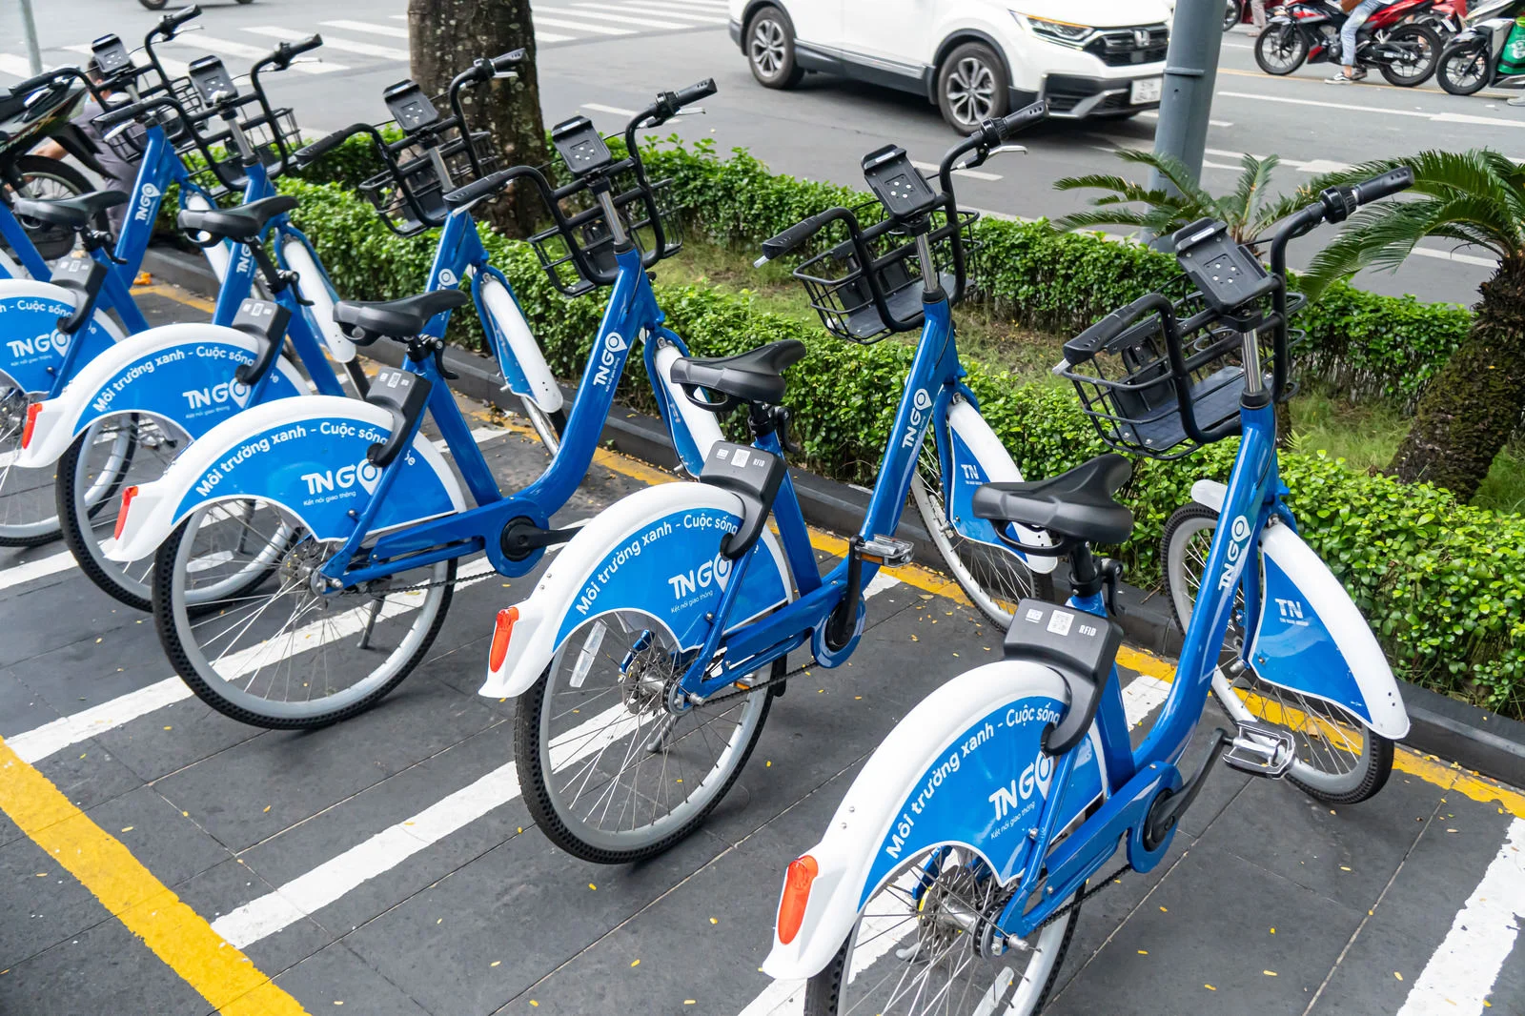
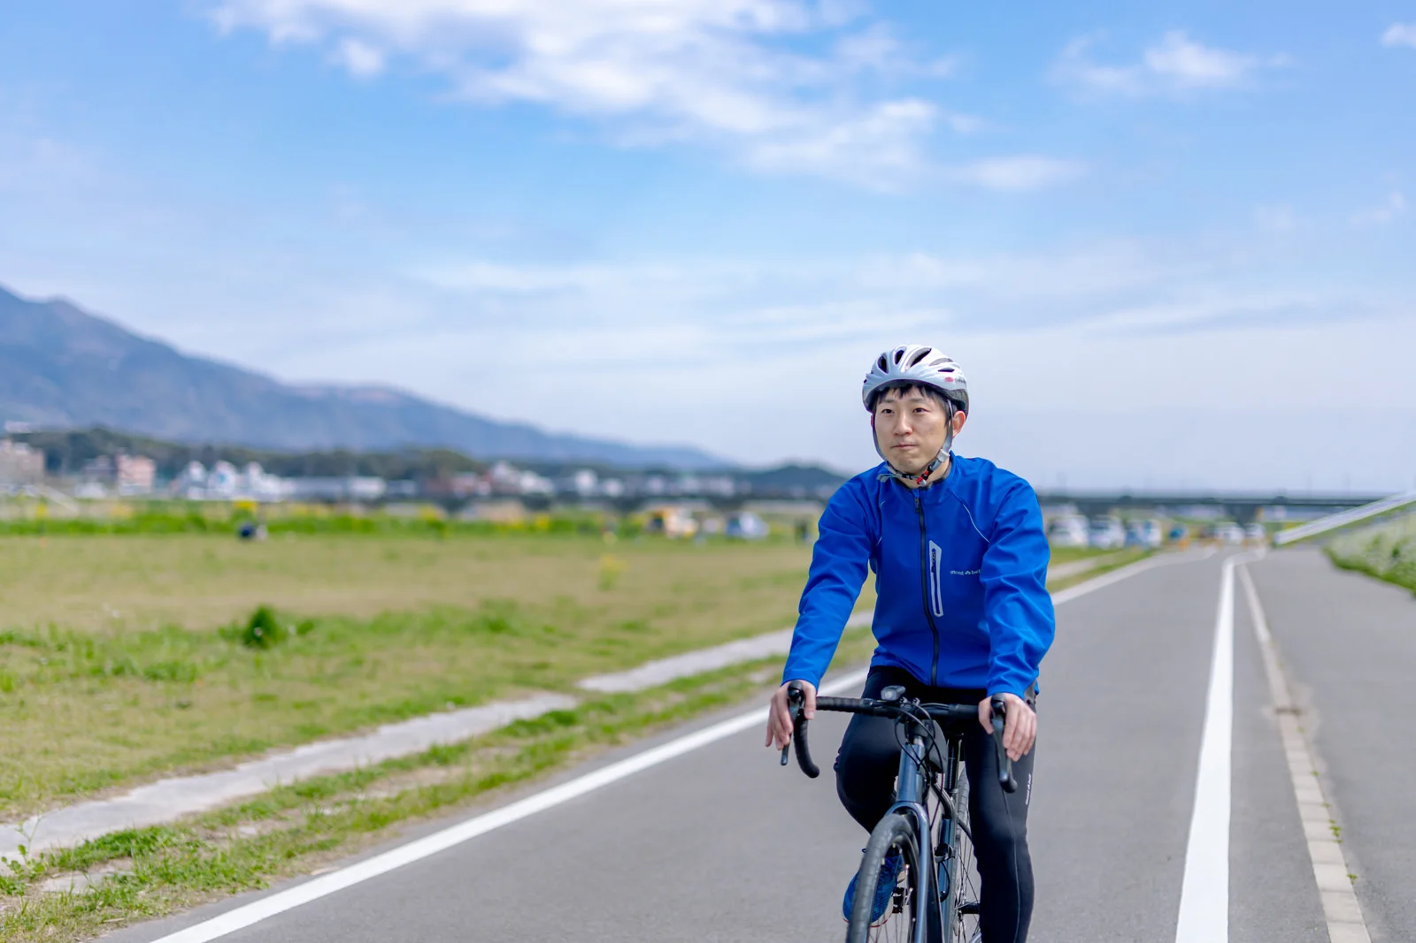
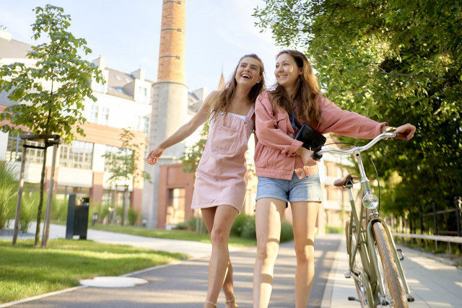
What kind of city is “bicycle-friendly?”
Give some examples.

Slide 6
Word Quiz
What is the meaning of “eco-friendly?”
① エコひいきする
② イイ子に優しい
③ 環境に優しい

Slide 7
Word Quiz
What is the meaning of “eco-friendly?”
① エコひいきする
② イイ子に優しい
③ 環境に優しい

Slide 8
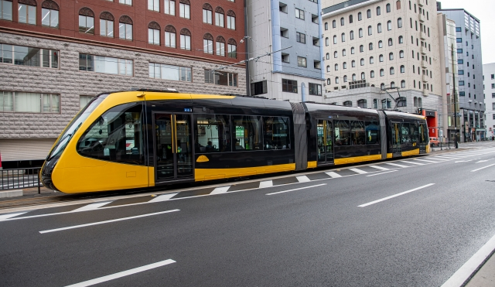
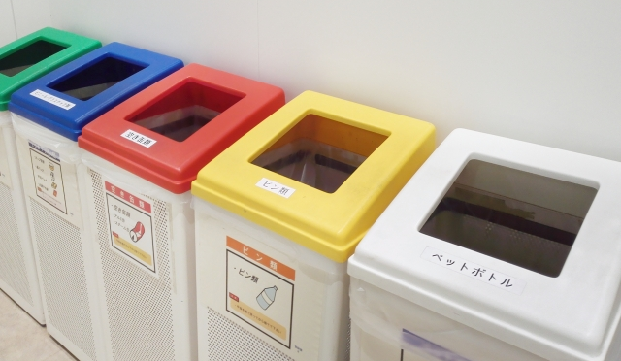

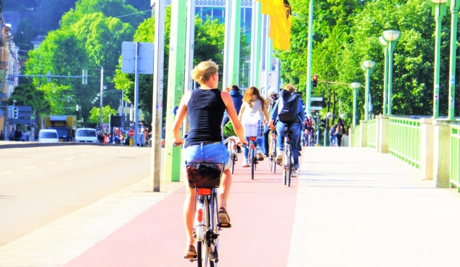
What kind of lifestyle is “eco-friendly?”
Give some examples.

Slide 9
Word Quiz
Create some new words using “-friendly”.
Examples:
・User-friendly: 使いやすい
・Pet-friendly: ペットに優しい、ペット同伴可能
・Family-friendly: 家族向けの
・Kid-friendly: 子供向けの、子供に優しい
・Health-friendly: 健康に良い
・Beginner-friendly: 初心者に優しい、初心者向けの

Slide 10

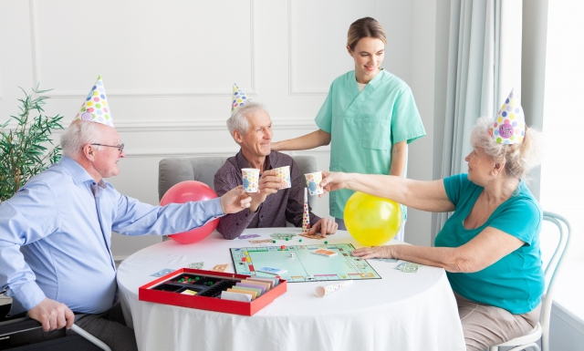
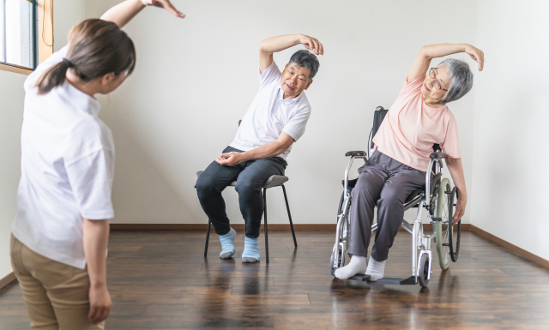

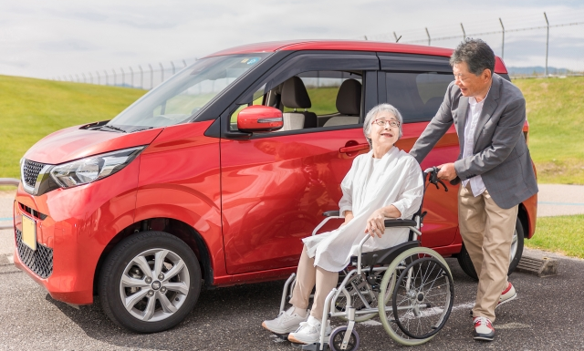
When you hear “age-friendly community,” what do you think of?

Slide 11
Read an article and summarize it!
Step 1
全文を読んで、概要を理解しよう
(5 mins)

Slide 12
Question
Does the author think the “age-friendly community” is good only for elderly people?
Yes or No

Slide 13
Read an article and summarize it!
Step 2
段落ごとに読んで、正確に理解しよう

Slide 14
Our society is aging quickly. To deal with this change, the idea of an "age-friendly community" was born. This is not just about helping older people. The main goal is to build strong relationships between all people, no matter their age. Kofi Annan, at the UN, explained this idea well in 1999. He was the seventh Secretary-General of the United Nations. He described a "Society for All Ages". This is a society where different generations are not separated, but work together for the same goals.
1

Slide 15
Question 1-①
Why did the age-friendly community movement start?
A: Because deal with the change of a rapidly aging society.
（急速な高齢化社会の変化に対応するため）

Slide 16
Question 1-②
What do many people agree is important in an age-friendly community?
A: An important goal is to build strong relationships between all people, no matter their age.
(年齢に関係なく、すべての人々の間に強固な関係を築くことが重要な目標である）

Slide 17
Question 1-③
Who was Kofi Annan?
A: He was the seventh Secretary-General of the United Nations.
（国連の７代目事務総長）

Slide 18
Question 1-④
How does an age-friendly community treat different age groups?
A: It means that people of all generations should not live apart but share goals and work together.
(あらゆる世代の人々が別々に暮らすのではなく、目標を共有して、一緒に取り組んでいくということ）

Slide 19
The World Health Organization (WHO) agrees with this broad vision. The WHO explains that aging is a lifelong process. It’s not something that only happens to old people; we are all aging every day of our lives. The organization also says that everyone should have the chance to age in a healthy way. To make sure people can live well in their later years, the WHO recommends that we must invest in our health at all stages of life.
2

Slide 20
Question 2-①
What does the World Health Organization (WHO) point out about aging?
A: It points out that aging is a lifelong process.
(老化は生涯にわたるプロセスであると指摘している）

Slide 21
Question 2-②
What does the World Health Organization (WHO) tell us to do for staying healthy as we age?
A: It tells us that we must invest in our health at all stages of life.
(私たちは人生のすべての段階で健康に投資しなければならない）

Slide 22
However, the real world is different from this ideal. Most "age-friendly" projects today focus mainly on older adults, their caregivers, and service workers. This focus is too narrow. As a result, the movement has not collected enough opinions from young people and families. We don't know enough about what they need for a good city life, or how they feel about working with older generations.
3

Slide 23
Question 3-①
What has the age-friendly community movement mostly focused on?
A： It has mostly focused on older adults, their caregivers, and service workers.
(主に高齢者、その介護者、サービス従事者に焦点を当ててきた）

Slide 24
Question 3-②
What has the age-friendly community movement not asked enough young people and families?
A: It has not asked enough about what they need for a good city life, or how they feel about working with older generations.
(若者やその家族が、良い都市生活のために何を必要としているか、あるいは他の世代と協力することについてどう感じているか聞くことができていない）

Slide 25
So why is there a gap between the vision and the reality? One possible reason is a common assumption: "what is good for older adults is good for everyone". People believe that if a city is good for older people, it will automatically be good for all ages. Of course, different generations share many interests. However, recent studies show that young adults and older adults in the US and Europe now think and vote very differently. This difference is bigger than at any time since the 1970s. These studies suggest a clear conclusion. To truly understand what makes a city good for all stages of life, it is necessary to gather data from multiple generations about what they need.
4

Slide 26
Question 4-①
Why is there a difference between the idea and the reality of an age-friendly community?
A: Because of a common assumption that "what is good for older adults is good for everyone".
(「高齢者にとって良いことは、すべての人にとっても良いことだ」という共通の思い込みのため）

Slide 27
Question 4-②
What do recent studies in the US and Europe show?
A: They show that young adults and older adults now think and vote very differently.
(若者と高齢者の習慣や態度は大きく異なる）

Slide 28
Question 4-③
What do we need to do to understand what makes a good city for all ages?
A: We need to gather data from multiple generations .
(若者、高齢者の両者にとっていい町とは何かを理解するために、全ての世代から情報を集める必要がある）

Slide 29
Read an article and summarize it!
Step 3
要約するために、英文の内容を整理してみよう

Slide 30
要約するために、英文の内容を整理してみよう
☆Theme of the entire text：
（英文全体のテーマ）
About（ ）
a truly “age-friendly” society
(真に “age-friendlyな”社会とは)

Slide 31
要約するために、英文の内容を整理してみよう
☆Author’s opinion：
〇Ideal：（ ）
〇Reality：（ ）
〇Cause：（
）
〇Solution：（
)
Society friendly to all age groups
Society focused only on elderly people
People think that what is good for elderly people is good for everyone
ask people of all ages what makes a city good for both young and old

Slide 32
Read an article and summarize it!
Step 4
STEP 3のまとめを参考に、英語で要約文を作ってみよう

Slide 33
【解答例】
To realize a truly age-friendly society, we should create a society that is friendly to all ages, but in reality the focus is on elderly people, because we often think that a society that is good for the elderly is good for everyone. Different generations have different ideas, so the opinions of all generations should be gathered.

Slide 34
Read an article and summarize it!
Step 5
STEP 3,4を参考にして、この文章の内容を70～80字の日本語で要約してみよう

Slide 35
【要約解答例】
全世代を視野に入れるべき【理想】町づくりが実際は高齢者優先になる【現実】のは、高齢者に良い社会は万人に良いと考えるからだ【理由】。考え方の異なる全世代から意見を募るべきである【解決策】。 （７６字）

Slide 36

10-minute break

Slide 37
⚽GOAL⚽
Let’s make Harmonia City a better place
with your wonderful ideas!

Slide 38
STEP 1: 全文を読んで概要を理解しよう
Harmonia City is a medium-sized city with a population of about 450,000.
About ten years ago, the city started a project called “A City Friendly for the Elderly.”

Slide 39

STEP 1: 全文を読んで概要を理解しよう
Since then,
Q1
These policies have made life easier for the elderly, and many people over 65 say they are very satisfied.

Slide 40
STEP 1: 全文を読んで概要を理解しよう
However, the city is now facing a new problem.
Young people and families are leaving Harmonia City.
Q2
The city has become safe and comfortable for seniors, but it is not so convenient or exciting for other generations.

Slide 41
STEP 1: 全文を読んで概要を理解しよう
Now, city leaders are asking a new question:
How can Harmonia City become a place that is truly good for all ages, not just for the elderly?

Slide 42
STEP 2: 全文を読んで概要を理解しよう
Since then,
Q1it has built many hospitals, nursing homes, and barrier-free apartments.
There are free buses for seniors, and many community centers offer classes such as calligraphy, dance, and health exercises for older people.
These policies have made life easier for the elderly, and many people over 65 say they are very satisfied.

Slide 43
STEP 2: 全文を読んで概要を理解しよう
However, the city is now facing a new problem.
Young people and families are leaving Harmonia City.
Q2
①There are few affordable apartments for young people, few kindergartens, and not enough public spaces where children can play.
②Transportation is also a problem—most buses run during the daytime for seniors, but not during rush hours for students and workers.
③In addition, most community activities are for older people.
Young people and children rarely have chances to meet or work with them.

Slide 44
STEP ３:
本文にある問題点のうちの1つを選び、
グループで高齢者と若者の両者にとってメリットのあるユニークな解決策を考えよう。
①～③の流れに沿って考えてみよう。
①Harmonia Cityが抱える問題
（そのことによって本文に書かれていること以外に起き得る問題も考えてみよう）
②解決策
③見込まれる効果、結果

Slide 45
STEP 4：世界中で実践されている解決策をみてみよう。
配布された英文を読んで要点をまとめ、班員に伝えよう。
実例１） Calgary, Canada – Listening to All Generations
実例２） The Netherlands – Students Living with Seniors
実例３） Toyama, Japan – A Compact City for All Ages

Slide 46
STEP 5:
STEP 4のヒントを元に自分たちの考えを深め
STEP 3を完成させましょう。
考えがまとまったら発表できるように練習をしましょう。

Slide 47
STEP ６：STEP ３の流れに沿って自分の考えを英語で書きましょう。語数は100語を目標にします。
テーマ：
How can Harmonia City become a place that is truly good for all ages, not just for the elderly?

