Slide 1




The 1st (Sep. 20th)
Inquiry Based Learning of English
The World Is Yours!!
By SAKAMOTO Yuko
&
TAKAKURA Keiichi

Slide 2
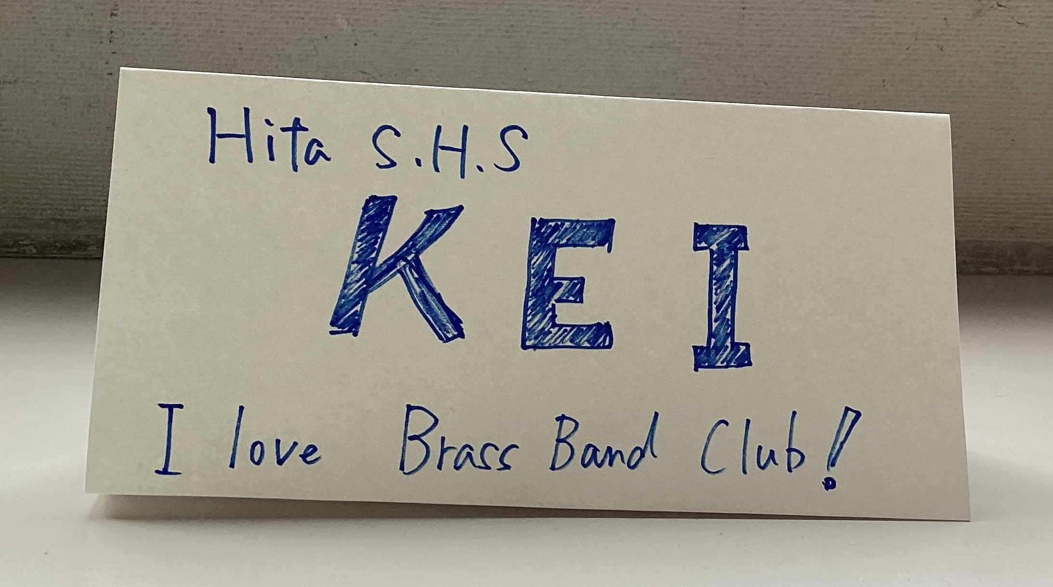
Before the Class Starts, Please Make a Self-Introduction Card!
The 1st Inquiry Based Learning of English
●Your Nickname
●Your School
●Best Thing in School Life

Slide 3


０:Introduction of Facilitators
The 1st Inquiry Based Learning of English
Sakamoto Yuko from Beppu Tsurumigaoka SHS
Takakura Keiichi from Hita SHS

Slide 4

Today’s Goals:
The 1st Inquiry Based Learning of English
1️⃣To summarize and communicate what ALTs say/write
about ‘ ‘ using MetaMoJi
2️⃣To state your opinion about ‘ ‘ using
MetaMoJi effectively
Listening/Reading
Speaking

Slide 5
Task1) Self-Introduction&Small Talk
What is the thing that you like the best in your school life?
The 1st Inquiry Based Learning of English
① 1 Minute Talk
② Q & A Session after Each Talk
MetaMoJi Page 1

Slide 6
Task 2) Lecture on Life:Listen & Retell
The 1st Inquiry Based Learning of English
① Watch a lecture video on philosophy(Part1).
(The professor will perform something.)
② Imagine the unseen parts,
and try to recreate them.
③ Retell the lecture (using pictures&key words) .
MetaMoji Page 2

Slide 7
Task 2) Lecture on Life:Listen & Retell
The 1st Inquiry Based Learning of English
🌟Rules🌟
① Only illustrations & key words in English.
During pair talk…
② English Only.
③ If your answer doesn’t match your partner’s,
you can watch the video again.
MetaMoji Page 2

Slide 8
Task3) Lecture on Life:Listen & Retell
The 1st Inquiry Based Learning of English
① Watch a lecture video on philosophy(Part2).
② Think about what each item represents.
Write the answer and other key words.
③ Give a lecture to your partner
pretending to be the professor. (Retelling)
MetaMoji Page 3

Slide 9
Task4) Reading:
The 1st Inquiry Based Learning of English
① Read the passage about life.
② Write short notes or keywords
on your worksheet.
③ Share what you understood from
the passage with your partner.
MetaMoJi Page 4

Slide 10
Task5) What do you compare your life to?
The 1st Inquiry Based Learning of English
① Think about your life!
② What do you compare your life to?
③ Draw a picture with some keywords.
④ Share your Idea with people in the room.
⑤ Write in a well-organized paragraph.
MetaMoJi Page 5

Slide 11


An Example of Takakura
Spices
Exciting Events
Rare
Things which enrich my life
Sometimes/Occasional
Important/Basic Part
Everyday

Slide 12
Task 7) Reflection
The 1st Inquiry Based Learning of English
Messages from Facilitators
MetaMoJi Page 6

Slide 13

The 1st Inquiry Based Learning of English
Thank you for your great performance!

