Slide 1
We are your trainers for today.
教科探究特別プログラム2025 英語 ２年第1回
T1: Naoki Fukuda
T2: Yusho Takahashi

Slide 2

Rule for pair work and group work
A
Left
B
Right
Respect your partner or group.

Slide 3
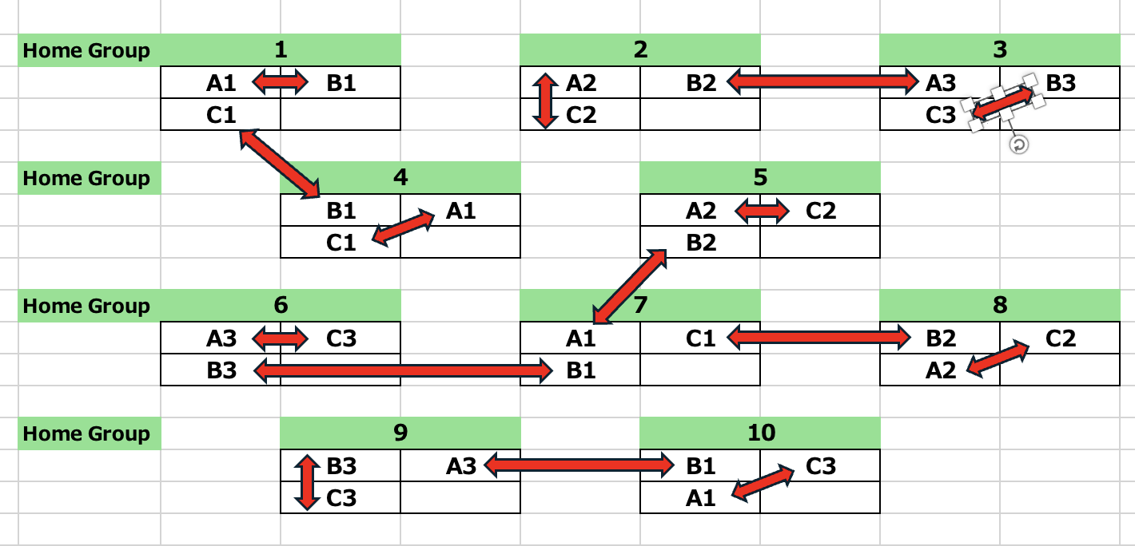
Home Group ⇄ Pair (A組)

Slide 4
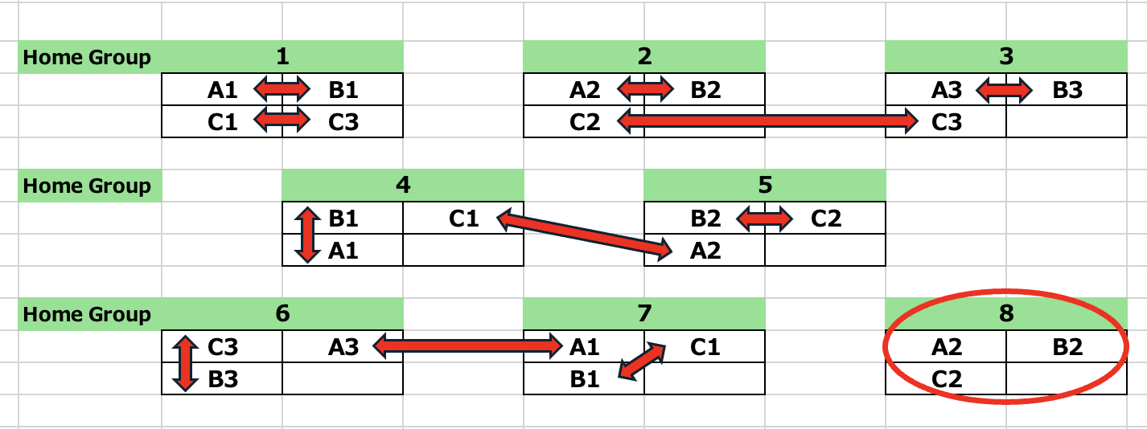
Home Group ⇄ Pair (B組)

Slide 5
①We are going to do everything in English. (Let’s try everything in English!) ②Enjoy speaking English. Don’t worry about making mistakes! (Mistakes are OK!)

Slide 6
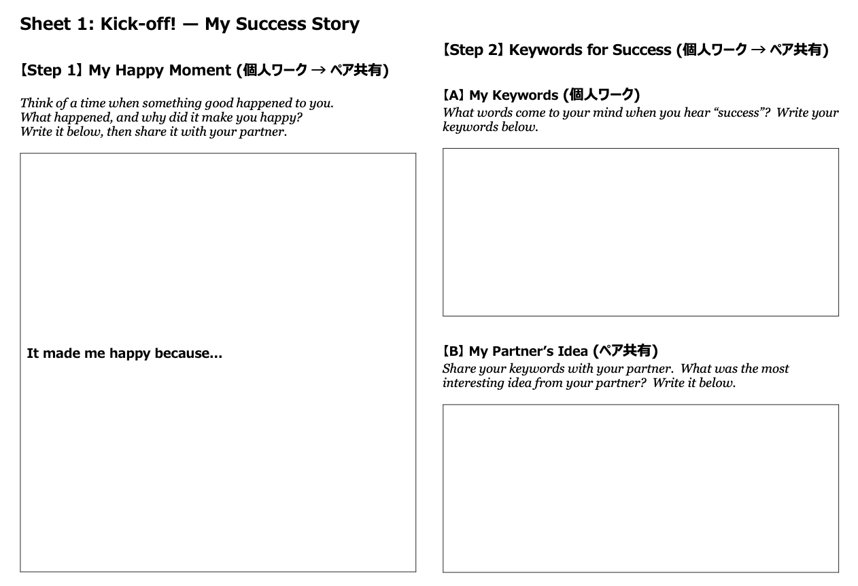

Icebreaker: My Happy Moment → Keywords for Success
Let’s use Sheet 1!

Slide 7
Step 1 1 min for Writing

Slide 8
Step 1 2 mins for Sharing

Slide 9
Step 2-A 1 min for Writing

Slide 10
Step 2-B 2 mins for Sharing

Slide 11

Our Big Question: What is success for you?

Slide 12

Today’s material A speech for High School Students by Former U.S. President

Slide 13
Main Task: Message Huntç
①Read YOUR part (A/B/C) of the speech.
②Find a message from by Former U.S. President that *impressed you the most.
*impress「影響を与える」

Slide 14
Jigsaw Reading: Experts
1 2 3
1 2 3
As
Bs
Cs
A
B
A
B
C
C
C
Notes:
Do you understand? For example, group 1 will read article A. group 2 will read article B, group 3, article C, group 4, article D.
Later, group 1 will be divided into 4 groups. And it is the same for group 2, group 3, and group 4.
So, in a new group, every one of you have read different articles. Basically, there are no one who have read the same article, so if you cannot explain the problem in your article, other members do not understand the problem.
I’ll give you 15 minutes to summarize your article. Help each other to understand the problem in your article, and practice explaining it to other groups.
OK, now we will give you your article.
OK, 15 minutes. Ready, go!

Slide 15
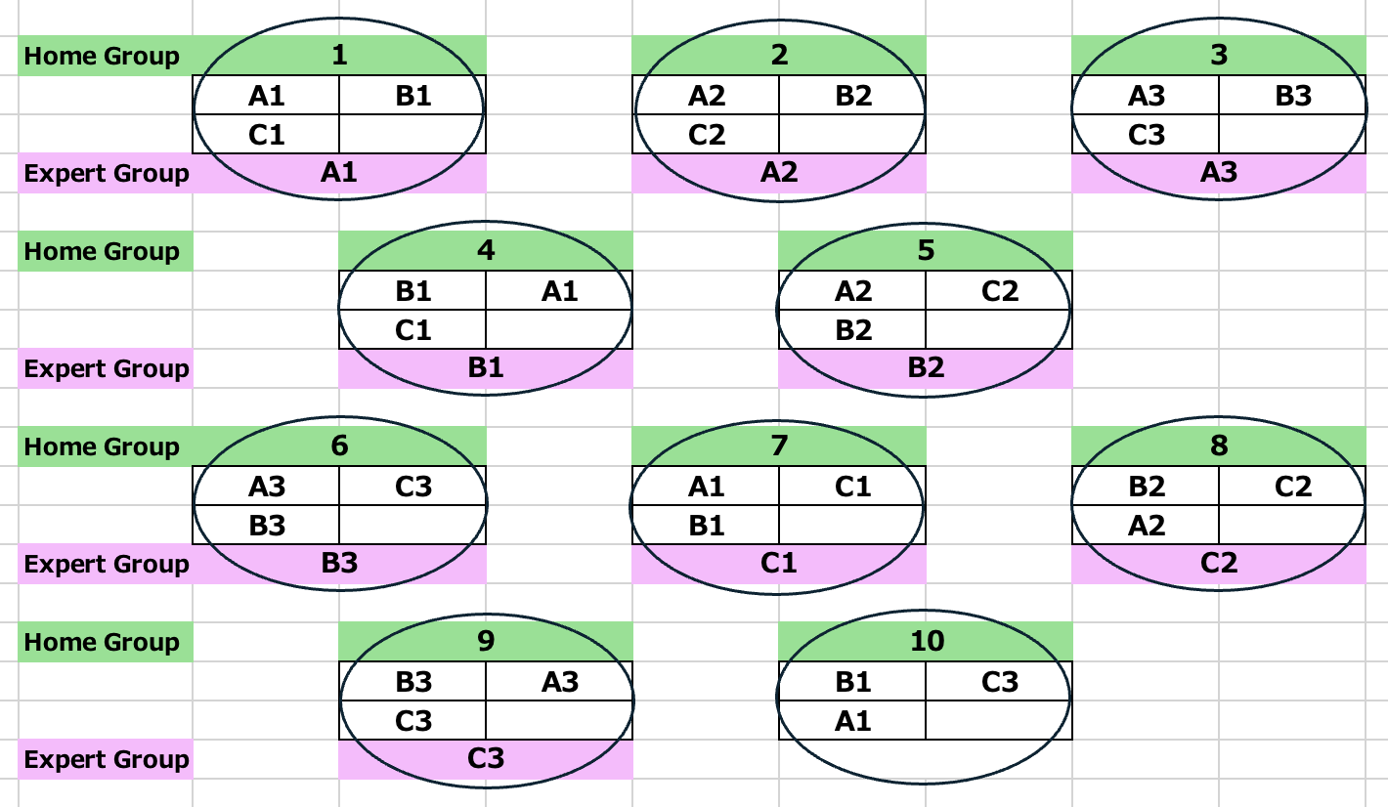
Home Group ⇄ Expert Group (A組)

Slide 16
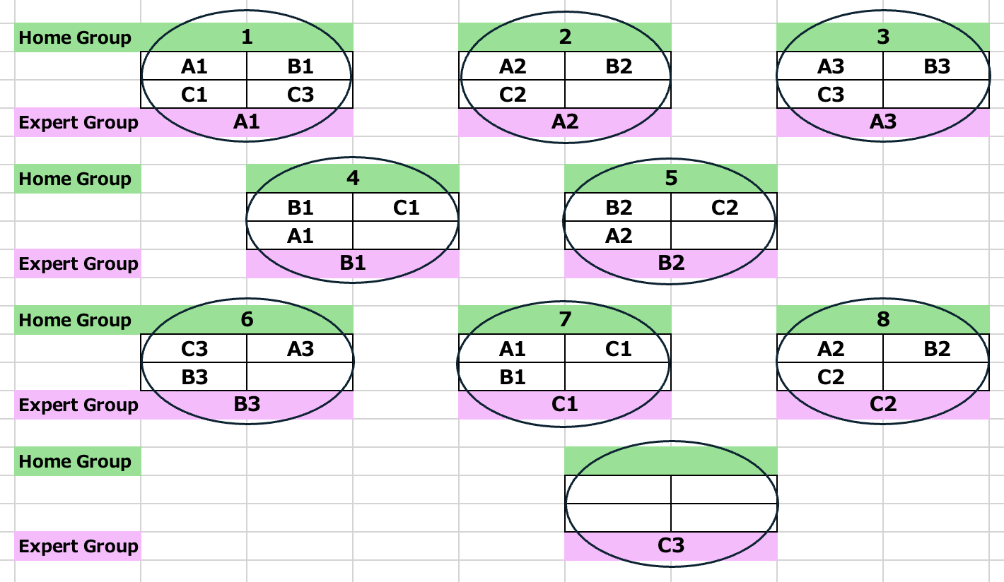
Home Group ⇄ Expert Group (B組)

Slide 17
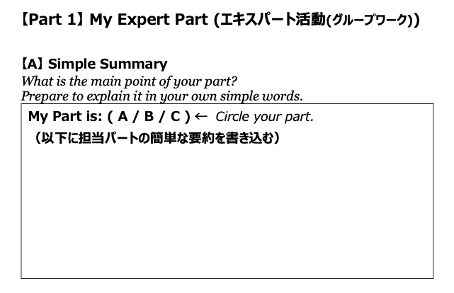
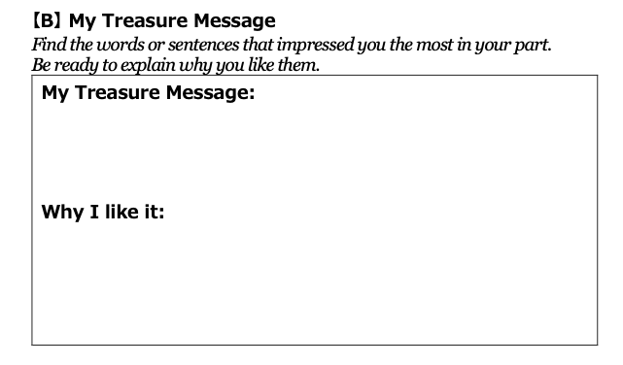
Expert’s Mission: Let’s use Sheet 2!
First, silent reading (5 mins).
Then, discuss in your small group (15 mins).

Slide 18
20 mins for Expert Activity

Slide 19
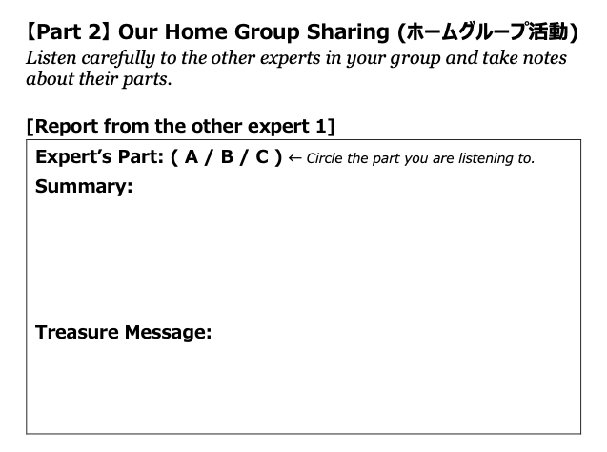
Home Group Sharing: Let’s use Sheet 2!
Total time: 10 mins
(Each person has about 3 mins).
Listeners, please take notes and ask questions!

Slide 20
10 mins for Home Group Sharing

Slide 21
Expression for ①
元の英文全体を簡単に言い換えたい場合
・・・ means that 〜.
「・・・は〜という意味です。」
使い方：”元の文”means that “自分の使える語彙や文法で簡単な英語にした文”.

Slide 22

Expression for ②
・I was impressed the most by・・ ・ .
「私は・ ・ ・という言葉に最も感動しました。」
・ I think it tells us that “自分の使える語彙や文法で簡単な英語にした文”.
「私はそのメッセージは私たちに“ 〜”ということを伝えてくれていると思います。」
・ I like this message because ・ ・ ・ .
「私がこのメッセージが好きな理由は・ ・ ・ です。」

Slide 23
Break Time 10 mins

Slide 25
Final Task

Slide 26
Former U.S. President gave this *inspiring speech to high school students — to YOU! *inspiring「奮い立たせてくれる」

Slide 27

Final Task: Let’s Write a Reply to Former U.S. President!

Slide 28
Big Question: What kind of person do you want to become in high school to make your high school life a success?

Slide 29
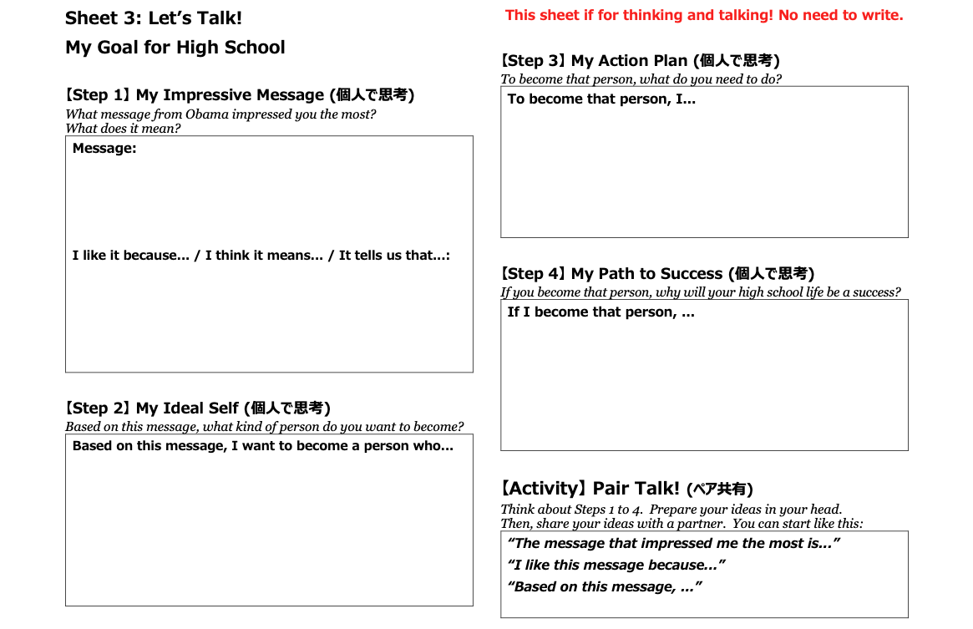
Let’s Talk!: Using Sheet 3!

Slide 30
Model
Step①: The message that impressed me the most is “The truth is being successful is hard.”
I like it because it tells us that we shouldn’t look for shortcuts, and that true success is built by working hard step-by-step.

Slide 31
Model
Step②: Based on this message, I want to become a person who doesn’t look for shortcuts and can work hard on things step-by-step, even if they are small.

Slide 32
Model
Step③: To become that person, I need to study my weak subjects every day.
I also want to continue my club activities, even when practice is hard.

Slide 33
Model
Step④: If I become that person, my high school life will be a success because I won’t be afraid of hard work, and challenge myself. Then I can grow as a person.

Slide 34
Expression
Step①: The message that impressed me the most is
“_________________________________________”.
I like it because _____________________________.
Step②: Based on this message, I want to become a person
who ____________________________________________.
Step③: To become that person, ______________________.
Step④: If I become that person, ______________________.

Slide 35
15 mins for Writing a Reply

Slide 36
10 mins for Home Group Sharing

Slide 37
WRAP IT UP!
Wrap up today’s lesson!

Slide 38

Be proud of yourself — and let’s all be proud together!
Let’s also be proud of each other
and of what we achieved today!

