Slide 1
The World Is Yours!
The 4th Inquiry based Learning of English
Ono Jyunki & Takakura Keiichi

Slide 2
The 4th Inquiry Based Learning of English
Before the class starts,
Please make a self-introduction card!
・Your name
・Your school
・Tough moment in your school life

Slide 3
The 4th Inquiry Based Learning of English
0:Introduction of Facilitators
Ono Jyunki from Hita Rinko SHS
Takakura Keiichi from Hita SHS

Slide 4
The 4th Inquiry Based Learning of English
Today’s Goals:
① To summarize and communicate what ALTs say about
‘ ‘ using Meta Moji
Listening
② To state your opinion about ‘ ‘ using Meta Moji effectively
Speaking

Slide 5
The 4th Inquiry Based Learning of English
Task 1) Warming Up: Jigsaw Activity
①To watch video out of four.
②To retell it pretending to be the person,
What do the ALTs talk about in common?
What do they value most in their life?
Meta Moji Page 1

Slide 6
The 4th Inquiry Based Learning of English
Task 1) Warming Up: Jigsaw Activity
Nitia / Trinidad and Tobago / Strong relationships
Meta Moji Page 1

Slide 7
The 4th Inquiry Based Learning of English
Task 1) Warming Up: Jigsaw Activity
Cayla / Texas, the U.S. / Making meaningful relationships with other people
Meta Moji Page 1

Slide 8
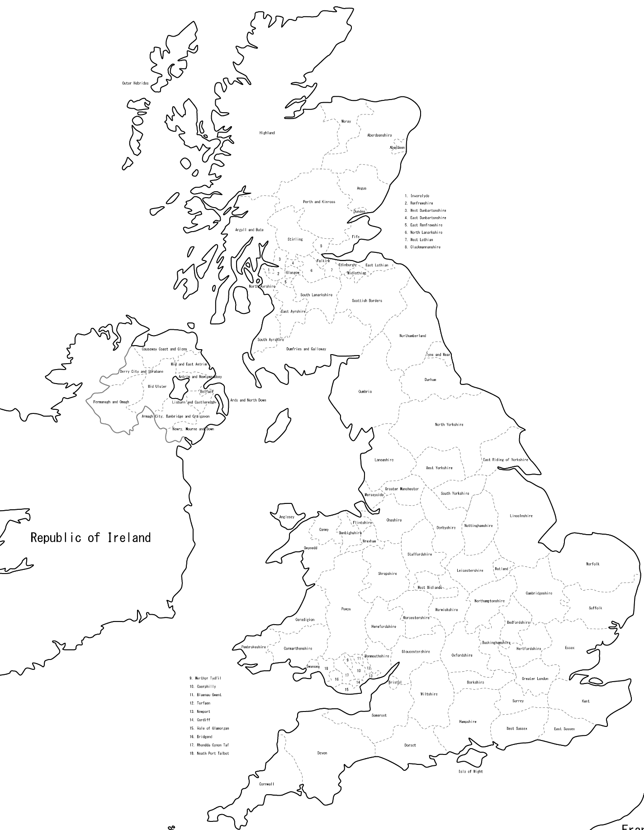
The 4th Inquiry Based Learning of English
Task 1) Warming Up: Jigsaw Activity
Becky / London, England /
Finding happiness in the small things in life
Meta Moji Page 1

Slide 9
The 4th Inquiry Based Learning of English
Task 1) Warming Up: Jigsaw Activity
Leanne / Texas, the U.S. / Being happy with what you get
Meta Moji Page 1

Slide 10
The 4th Inquiry Based Learning of English
Task 2) Small Talk
When do you feel your school life is tough?
① 1 Minute Talk
② 2 Minutes Preparation
③ Q&A Session after Each Talk
Meta Moji Page 2

Slide 11
The 4th Inquiry Based Learning of English
Task 3) Lecture on Life: Listen & Retell
① Watch a lecture video on philosophy (Part 1)
(The professor will perform something.)
② Imagine the unseen parts, and try to recreate them.
③ Retell the lecture (using pictures & key words).
Meta Moji Page 3

Slide 12
The 4th Inquiry Based Learning of English
Task 3) Lecture on Life: Listen & Retell
Rules
① Only illustrations & key words in English.
During pair talk…
② English Only.
③ If your answer doesn’t match your partner’s, you can watch
video again.
Meta Moji Page 3

Slide 13
The 4th Inquiry Based Learning of English
Task 4) Lecture on Life: Listen & Retell
① Watch a lecture video on philosophy (Part 2).
② Think about what each item represents.
Write the answer and other key words.
③ Give a lecture to your partner pretending to be a professor.
(Retelling)
Meta Moji Page 4

Slide 14
The 4th Inquiry Based Learning of English
Task 5) think about Your Life
① Think about your life!
② Try to fill up the jar with the items.
③ How is your life occupied with them?
④ Share your situation with your group members.
Meta Moji Page 5

Slide 15
The 4th Inquiry Based Learning of English
Task 6) What do you compare your life to?
① Think about your life!
② What do you compare your life to?
③ Draw a picture with some keywords.
④ Share your idea with people in the room.
⑤ Write in a well-organized paragraph.
Meta Moji Page 6

Slide 16
Spices
Exciting Events
Rare
Things which enrich my life
Sometimes / Occasional
Important / Basic Part
Everyday

Slide 17
The 4th Inquiry Based Learning of English
Task 7) Reflection
Messages from Instructors
Meta Moji Page 7

