Slide 1
教科探求プログラム 1回目 2年英語
Opening

Slide 2
Should we still learn
foreign languages？

Slide 3
Switch your Brain
to English Mode

Slide 4
What language do you
want to learn
other than English？
（2 min ⇒ 1 min）

Slide 5
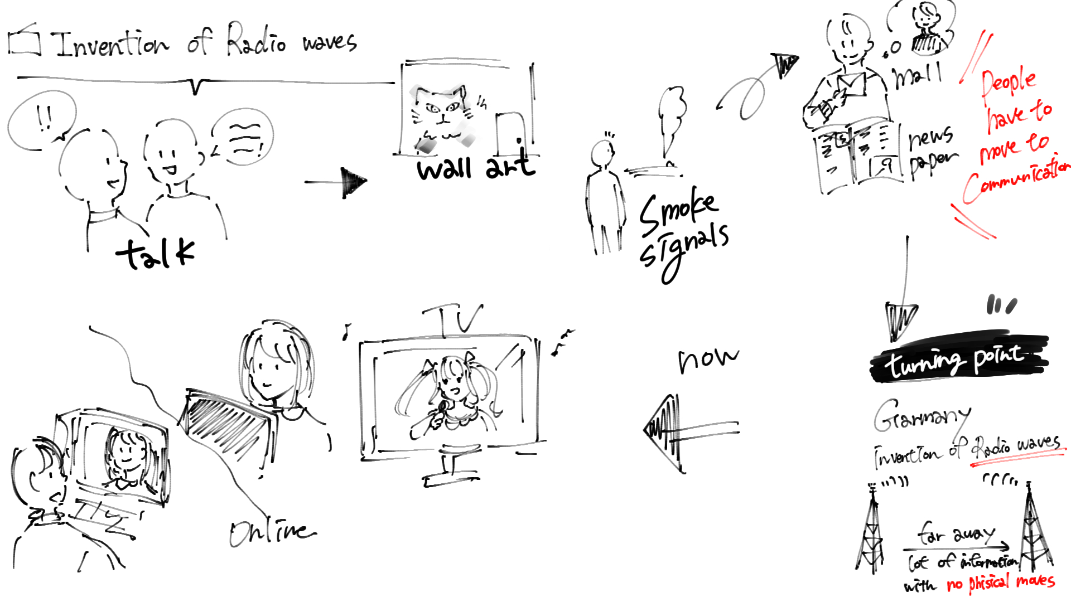
Mapping

Slide 6
What language do you
want to learn
other than English？
（2 min ⇒ 1 min）

Slide 7
Session 1

Slide 8
SNS

Slide 9
AI Translation Tools Support National Indigenous Language Policies

Slide 10
Question 1-1
How will education
in this country
change
if this policy is introduced?
（3 min ⇒ 1 min）

Slide 11
Question 1-2
Should Japan introduce
these AI tools
to high school & university？
（3 min ⇒ 1 min）

Slide 12
interview

Slide 13
psychology:
The benefits of being bilingual

Slide 14
Question 2-1
If people can speak
two or more languages,
what ability can they have？
（3 min ⇒ 1 min）

Slide 15
Question 2-2
When you spoke English,
what have you learned
from such experiences？
（3 min ⇒ 1 min）

Slide 16
news

Slide 17
Japanese startup
to use AI
to translate manga

Slide 18
Question 3-1
Which do you think
is the most attractive point
of this AI？
（3 min ⇒ 1 min）

Slide 19
Question 3-2
Choose your favorite manga,
and make a presentation
to sell this AI
to its publisher.
（3 min ⇒ 1 min）

Slide 20
report

Slide 21
An AI competed against
a human debate champion.

Slide 22
Question 4-1
What is the difference
between AI and humans
when they argue
with each other？
（3 min ⇒ 1 min）

Slide 23
Question 4-2
How would you debate
with AI
about the topic below？
（3 min ⇒ 1 min）
“Should teachers increase
your English homework？

Slide 24
Session 2

Slide 25
Should we still learn
foreign languages？

Slide 26
picture

Slide 27
A photographer
saves
a turtle

Slide 28
Question 5-1
What message
did those pictures spread？
And how did they
reach the world？
（3 min ⇒ 1 min）

Slide 29
Question 5-2
Have you felt that
“a picture is worth
a thousand words”？
Tell your experience.
（3 min ⇒ 1 min）

Slide 30
biography

Slide 31
How Politicians
Used Language
to Build a Nation

Slide 32
Question 6-1
What and how
did He learn
at the prison？
（3 min ⇒ 1 min）

Slide 33
Question 6-2
As a U.N. staff member,
what program would you
propose to
Israeli & Palestinian schools to solve the conflict？
（3 min ⇒ 1 min）

Slide 34
interview
news
picture
SNS
report
biography

Slide 35
What are differences
between today’s articles？

Slide 36
Education
to learn foreign languages
is no longer needed.
Education
to learn foreign languages
is still needed.

Slide 37
Should we still learn
foreign languages？

Slide 38
Debate
front
Yes
No
Yes
No
Yes
No
Yes
No
Yes
No
Yes
No
Yes
No

Slide 39
Debate
front
Yes
No
Yes
No
Yes
No
Yes
No
Yes
No
Yes
No
Yes
No

Slide 40
Debate

Slide 41
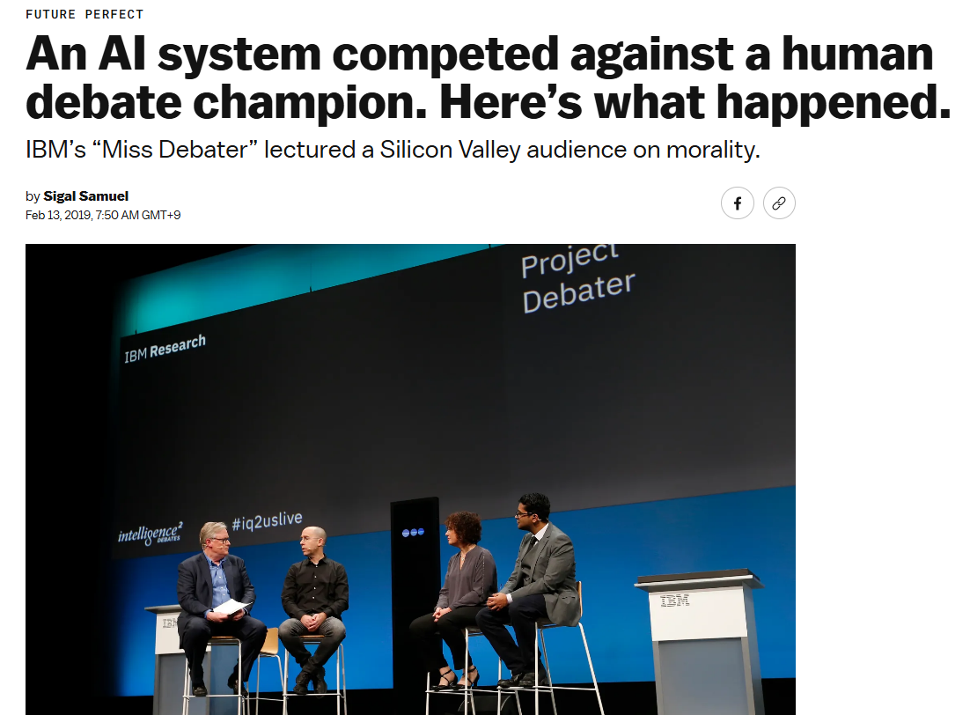
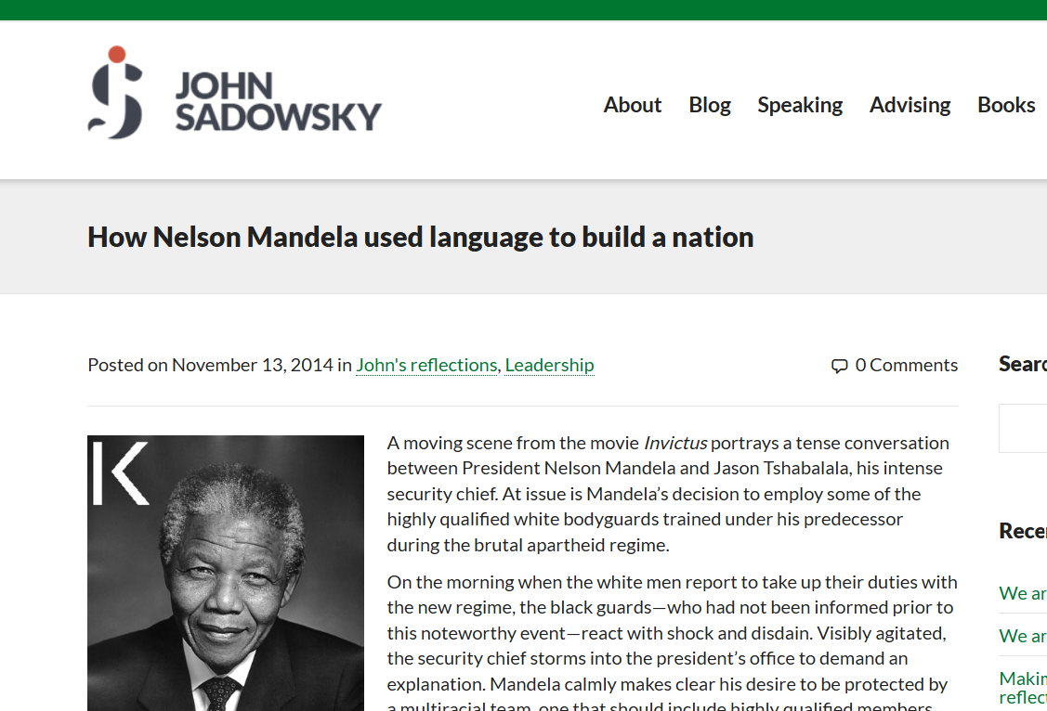
Debate
psychologist
debate champion
politician

Slide 42
Debate
psychologist
debate champion
politician

Slide 43
Debate
reason
&
example
psychologist
reason
&
example
reason
&
example
debate champion
politician

Slide 44
Debate
front
Yes
No
Yes
No
Yes
No
Yes
No
Yes
No
Yes
No
Yes
No

Slide 45
Debate
front
Yes
No
Yes
No
Yes
No
Yes
No
Yes
No
Yes
No
Yes
No

Slide 46
Debate

Slide 47
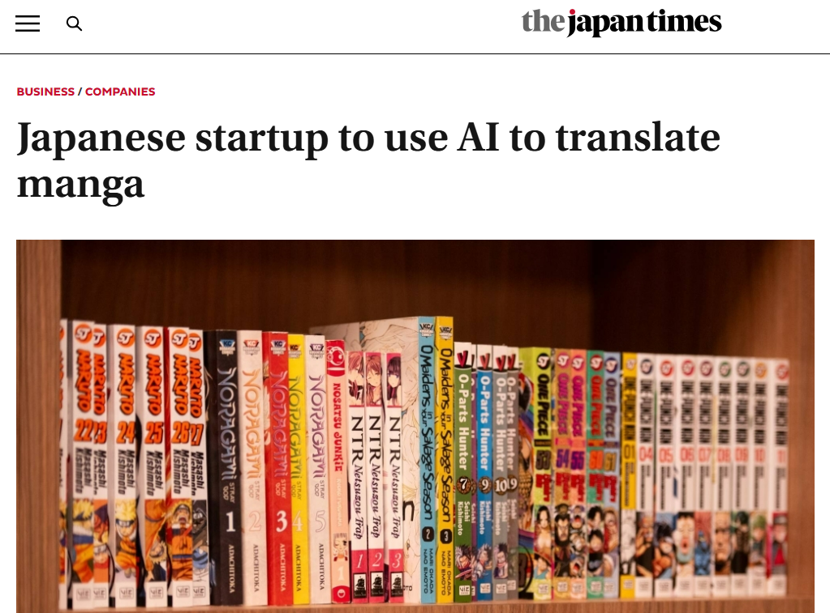
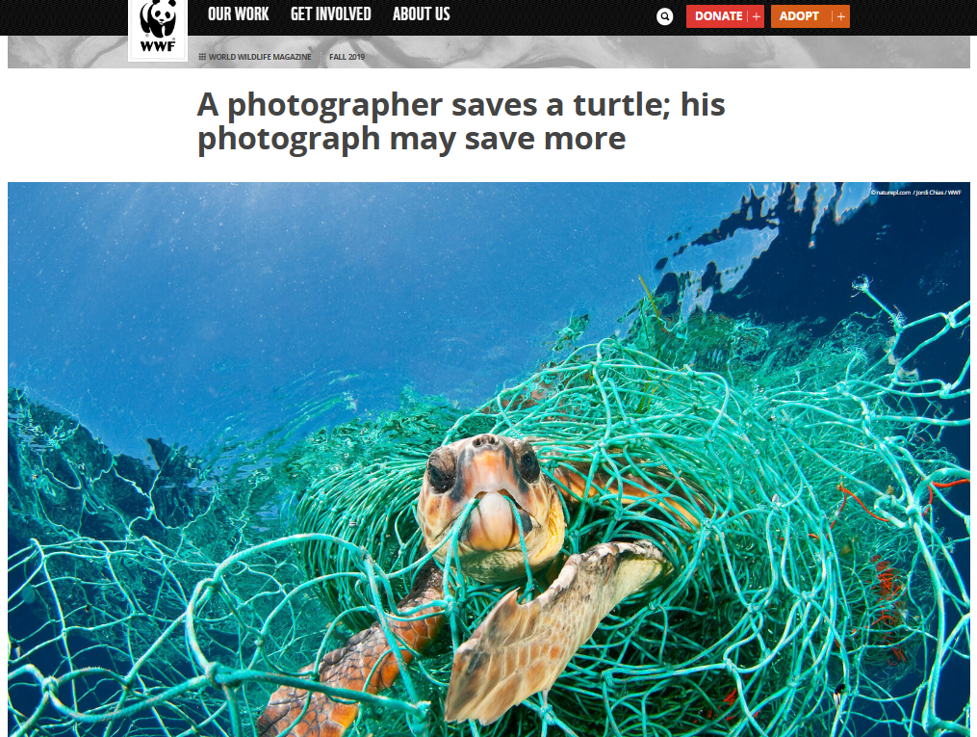
Debate
student
publisher
photographer

Slide 48
Debate
student
publisher
photographer

Slide 49
Debate
reason
&
example
student
reason
&
example
reason
&
example
publisher
photographer

Slide 50
Debate
【準 備】 5 min
※誰がどの立場で主張するか決める
※各自で理由と具体例を考える
----------------------------------------------------------
【第１部】 3 min
※交互に理由と具体例を主張する
【第２部】 1 min
※チーム内で質問を１つ考える
【第３部】 1 min
※交互にQ&Aを行う

Slide 51
Debate
【準 備】 5 min
※誰がどの立場で主張するか決める
※各自で理由と具体例を考える
----------------------------------------------------------
【第１部】 3 min
※交互に理由と具体例を主張する
【第２部】 1 min
※チーム内で質問を１つ考える
【第３部】 1 min
※交互にQ&Aを行う

Slide 52
Debate
front
Yes
No
Yes
No
Yes
No
Yes
No
Yes
No
Yes
No
Yes
No

Slide 53
Debate
front
Yes
No
Yes
No
Yes
No
Yes
No
Yes
No
Yes
No
Yes
No

Slide 54
Debate
Yes
No

Slide 55
Debate
Yes
No
reason
&
example

Slide 56
Debate
Yes
No
reason
&
example

Slide 57
Debate
Yes
No
reason
&
example

Slide 58
Debate
Yes
No
reason
&
example

Slide 59
Debate
Yes
No
reason
&
example

Slide 60
Debate
Yes
No
reason
&
example

Slide 61
Debate
You mean…
But I think…
This is because…
For example,…

Slide 62
Debate
Yes
No
question

Slide 63
Debate
Yes
No
answer

Slide 64
Debate
Yes
No
question

Slide 65
Debate
Yes
No
answer

Slide 66
Debate
When… What…
Where… Why…
Who… How…

Slide 67
Debate
【準 備】 5 min
※誰がどの立場で主張するか決める
※各自で理由と具体例を考える
----------------------------------------------------------
【第１部】 3 min
※交互に理由と具体例を主張する
【第２部】 1 min
※チーム内で質問を１つ考える
【第３部】 1 min
※交互にQ&Aを行う

Slide 68
Debate
【準 備】 5 min
※誰がどの立場で主張するか決める
※各自で理由と具体例を考える
----------------------------------------------------------
【第１部】 3 min
※交互に理由と具体例を主張する
【第２部】 1 min
※チーム内で質問を１つ考える
【第３部】 1 min
※交互にQ&Aを行う

Slide 69
Debate
【準 備】 5 min
※誰がどの立場で主張するか決める
※各自で理由と具体例を考える
----------------------------------------------------------
【第１部】 3 min
※交互に理由と具体例を主張する
【第２部】 1 min
※チーム内で質問を１つ考える
【第３部】 1 min
※交互にQ&Aを行う

Slide 70
Should we still learn
foreign languages？

Slide 71
Essay
【主 張】 I （don’t） think we should…
【理 由】 That’s because…
【具体例】 For example, …
【反 論】 On the other hand, …
【再反論】 However （But）, …
【結 論】 That’s why…

Slide 72
What did you learn today？

Slide 73
interview
news
picture
SNS
report
biography

Slide 74
interview
news
picture
SNS
report
biography
opinion

Slide 75
Diversity （多面性）

Slide 76
How will you make use of
the learning today？

Slide 77
教科書 ＋α

Slide 78
Ending

Slide 79
How do you learn
foreign languages？

