Slide 1
第４回
教科探究プログラム
1年 英語
講師:藤田 靖剛
麻生 朋成
R6.12.21（土）
大分県教育センター

Slide 2
What do you want for Christmas？

Slide 3
８

Slide 4
16

Slide 5
Today’s Goal!!
読むことと聞くことを通して、
物語の情景や登場人物の心情を理解し、
登場人物の会話を想像して、
ロールプレイの中で英語で表現する
ことができる。

Slide 6
Today’s plan!!
Warm-up (the 1st paragraph)
2. Reading 1 (the 2nd paragraph ~ the 5th paragraph)
3. Reading 2 (the 6th paragraph ~ the 8th paragraph)
〜 Break 〜
4. Skit Making
5. Role Play
6. Reflection

Slide 7
Warm up!!
Please imagine the story
with some key words.

Slide 8
Warm up!!
It’ s
1914. t
he British and German u. sh military
nervous, sn enemy ay attack ur
Christmas or
New Year.

Slide 9
Warm up!!
On the night of December 24, 1914, Christmas Eve, the sky was clear, and the cold air filled the atmosphere. The moonlight illuminated the snowy landscape, and the ground was covered in a blanket of white. Outside a small town in northern France, the British and German trenches faced each other. The British military headquarters grew nervous and sent the following warning to the front lines: "There is a possibility that the enemy might launch an attack on Christmas or New Year. I repeat, the enemy might launch an attack on Christmas or New Year." Yet, the military command had no way of knowing what would actually happen.

Slide 10
Warm up!!
It’ s Christmas Eve. December 24, 1914. The night is clear and cold. Moonlight illuminates the snow covered land separating the British and German trenches outside a small town in northern France. British military command, feeling nervous, sends a message to the front lines: it is thought possible the enemy may attack during Christmas or New Year. Extra caution will be maintained during this period. The military command has no idea what’s really about to happen.
Please answer
５W1H Questions
Who? What? Where? When? Why？How?

Slide 11
Warm up!!
How to answer 5W1H Questions
Who?→ Many high school students
What?→ are studying English
Where?→ at Oita Prefectural Education Center
When?→ on December 21, 2024
Why?→ English workshop
How?→ They are guessing what kind of story
it is.

Slide 12
Warm up!!
Who?→ British and German military
What?→ are fighting
Where?→In northern France,
near a small town
When?→ on December 24, 1914
Why?→ War (World WarⅠ)
How?→ there is a chance the enemy
might attack during Christmas
or New Year.

Slide 13
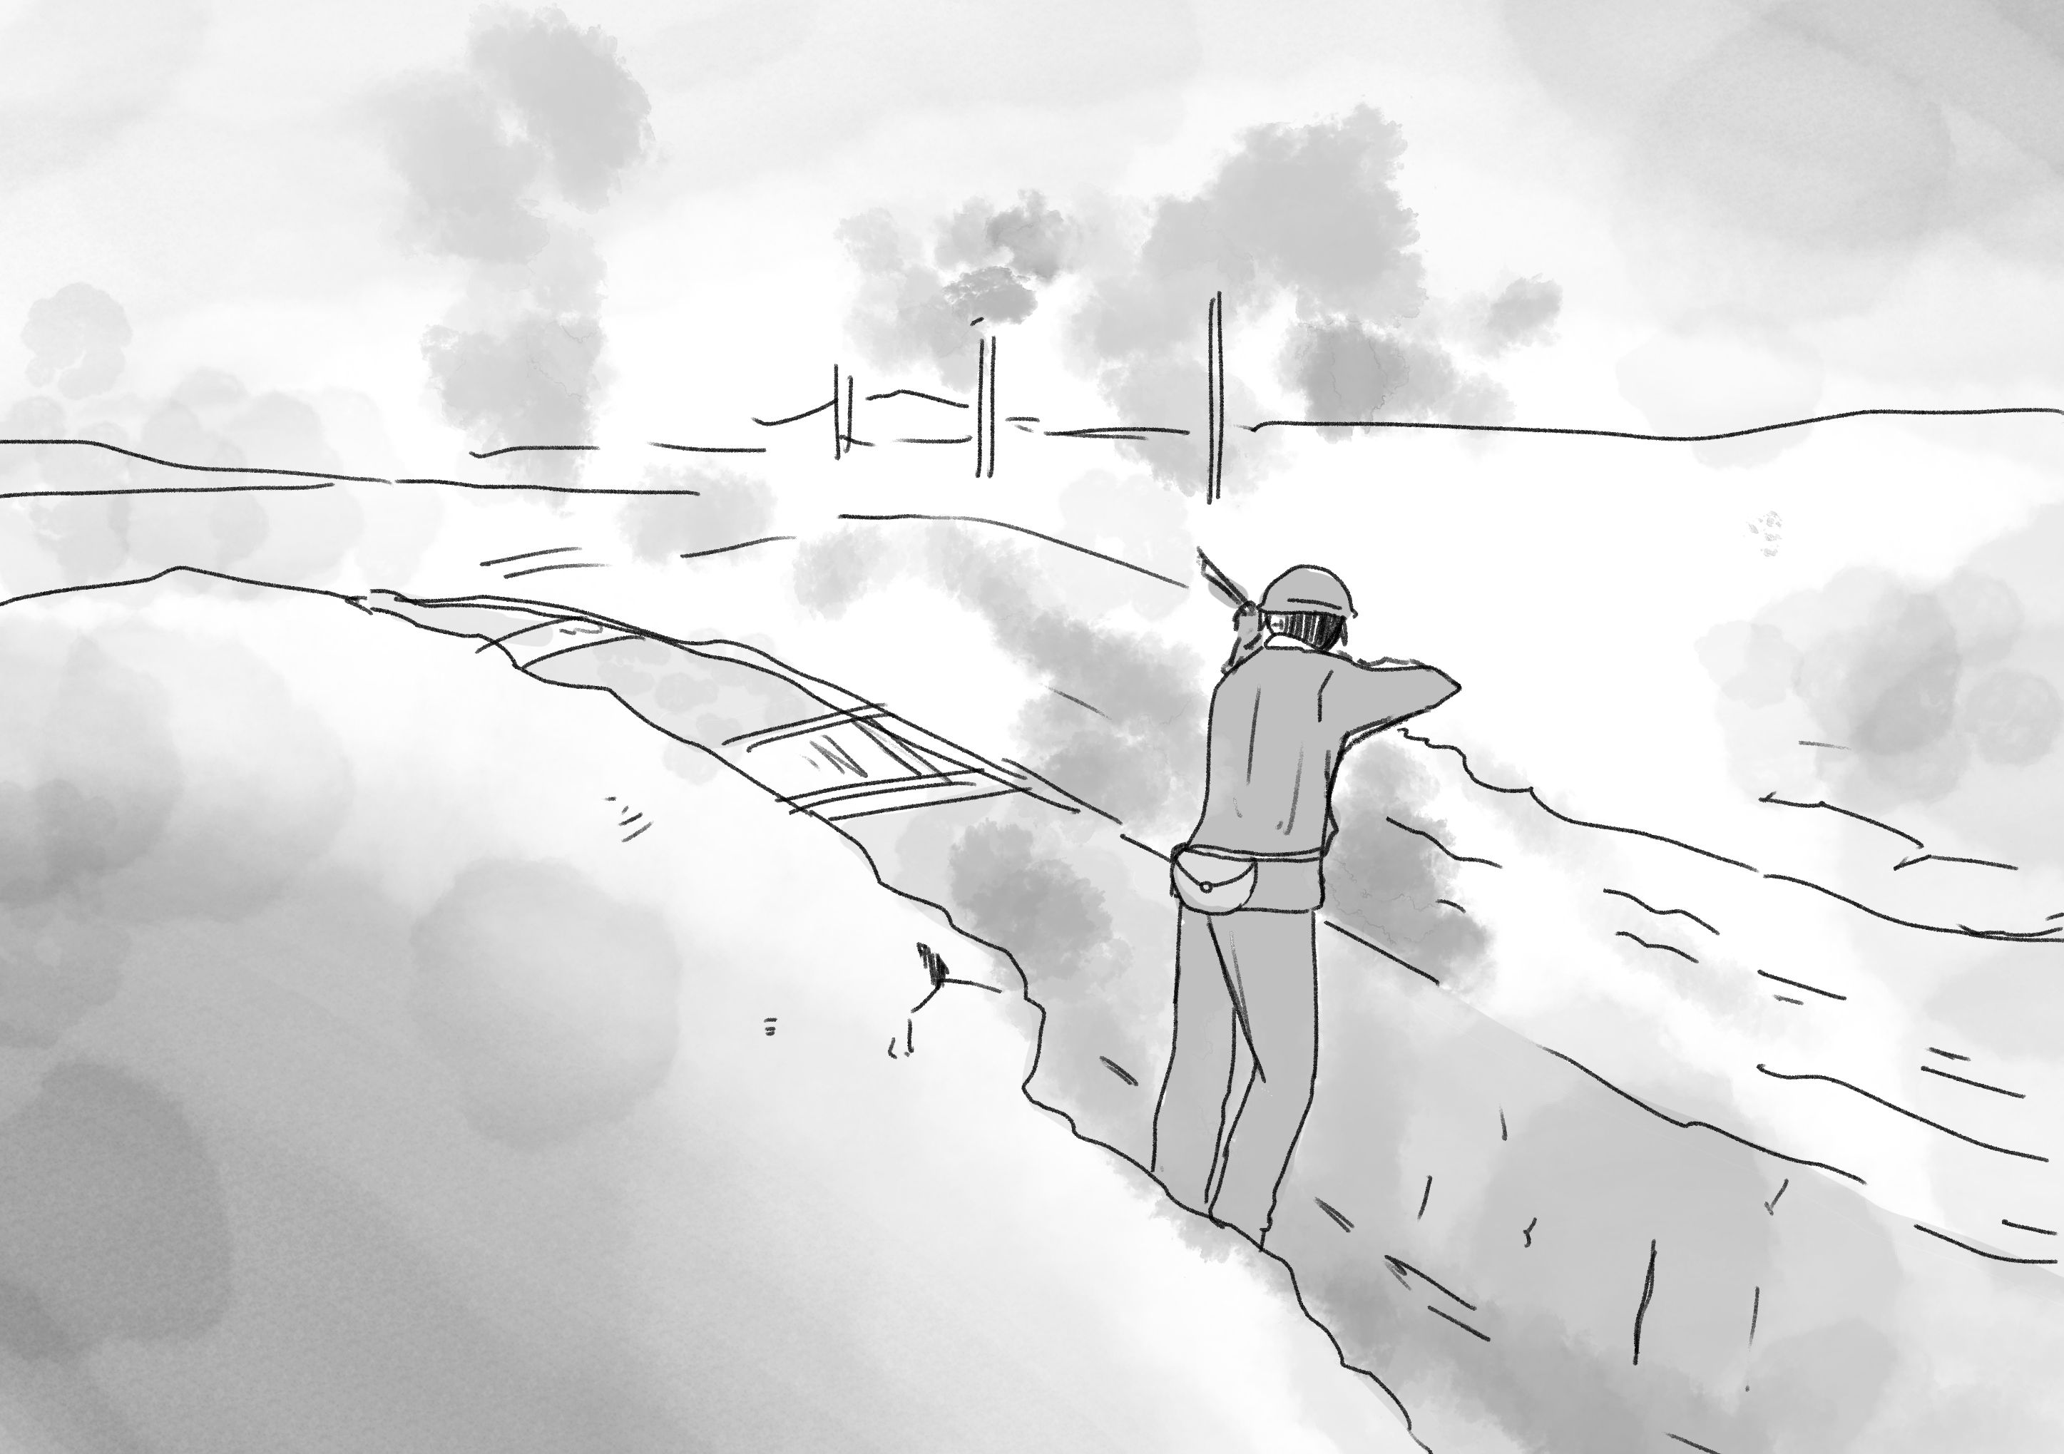
Warm up!!
trenches

Slide 14
Reading 1
MetaMoji
Q2. 第 〜 段落を読んで、内容を2枚の絵に描きなさい。
（第 段落の絵 、第 段落の絵）
1枚 1枚 ☆ペアで分担してもOK
2
５
2
3
４
５

Slide 15
Reading 1
Light flickers on

Slide 16
Reading 1
Light flickers on
Flicker
Flash

Slide 17
Reading 1
Question:
If you were in his position,
would you go into the field between both armies?
Why? / Why not?

Slide 18
Reading 2
MetaMoji
Q3. 第 〜 段落を読んで、内容を2枚の絵(2つの場面)
に描きなさい。 ☆ペアで分担してもOK
６
８

Slide 19
Reading 2
The soldiers from Country A offered chocolate, tea, and cakes, while those from Country B shared cigars, sauerkraut, and schnapps.
sauerkraut, schnappsとは？？

Slide 20
Reading 2
Sauerkraut
Schnapps

Slide 21
Take a Break!!
Take a break for 10 minutes.
If you haven’t finished drawing the picture, please finish it up.

Slide 22
Today’s Goal!!
読むことと聞くことを通して、
物語の情景や登場人物の心情を理解し、
登場人物の会話を想像して、
ロールプレイの中で英語で表現する
ことができる。

Slide 23
Make a Skit!!
Work Sheet
Imagine the conversation
between a British soldier and a German soldier at the party.
場面設定（ナレーション）British soldierとGerman soldierの会話を想像して、どのような言葉が交わされたのか、Skit（寸劇）の原稿を考える。
合計３分程度
○１分（作成した絵を使ってナレーション）
－これまでの場面を踏まえたナレーション（２人）
○１分半（兵士たちの会話）

Slide 24
Make a Skit!!
Role play
Narrator・・・2人
British soldier・・・１人
German soldier・・・1人

Slide 25
Make a Skit!!
On Christmas Eve, 1914
Narrators
Picture１（1～5 paragraph）
Picture２ (6～8 paragraph)
The next morning, Christmas day
Narrator①
Narrator②
That evening, they held parties up and down the lines.
What were they talking about during the party?

Slide 26
Role Play!!
Desk
Narrator① | British soldier
Narrator② | German soldier

Slide 27
Role Play!!
Work Sheet
Imagine the conversation
between a British soldier and a German soldier at the party.
Example
family
home town
after the war

Slide 28
Role Play!!
Work Sheet
Imagine the conversation
between a British soldier and a German soldier at the party.
Narrator（2名)・British soldier・German soldier
配役を決定後、skitの作成を行ってください。
Skit(Narration)作成： | 12分
練習： | ８分
各班の発表： | ３分程度

Slide 29
Role Play!!
～listeners～
After the role play, please tell the best point of the group in Japanese. (1min）
Example
・会話の内容
・ナレーションの分かりやすさ
・使っていた英語について（量、表現の豊かさ等）

Slide 30
Role Play!!
Role play①
Show your role play (3min)
Listeners
Tell the best point of the group in Japanese after the role play. (1min）

Slide 31
Role Play!!
Role play②
Show your role play (3min)
Listeners
Tell the best point of the group in Japanese after the role play. (1min）

Slide 32
Role Play!!
Metamoji
Question
How did the soldiers feel during the party?

Slide 33
Role Play!!
Metamoji
Share your opinions in a group(2min)

Slide 34
The Final Question!!
Metamoji
Question
What title would you give this story?

Slide 35
The Final Question!!
For a long time, the Christmas truce of 1914 was thought to be nothing more than a myth—a sentimental story with no basis in reality. After the holiday, the war resumed, and millions more soldiers lost their lives. As time passed, the events of that Christmas seemed almost impossible to believe. However, thanks to countless interviews with the soldiers who were there, we now know that more than 100,000 soldiers from Country A and Country B truly laid down their weapons that day.
Work Sheet

Slide 36
The Final Question!!
Work Sheet
”Christmas truce”
和訳を考えてみよう。

Slide 37
The Final Question!!
Work Sheet
”Christmas truce”
クリスマス休戦

Slide 38
Reflection!!
本日の講義の振り返りを行いましょう！
読むことと聞くことを通して、
物語の情景や登場人物の心情を理解し、
登場人物の会話を想像して、
ロールプレイの中で英語で表現する
ことができる。
Thank you very much for your cooperation.
Hoping you will learn English more and improve your English ability from now on!

Slide 39
We wish you a merry Christmas!

