Slide 1
第3回 教科探究プログラム 1年生対象【英語】
ファシリテーター：中村 真紀（国東）
藤井 礼（別府翔青）
R6 11.16（土）大分県教育センター

Slide 2
【Warm-up】
Self-introduction
＊name
＊school
For example:
① visit Britain and Spain
② be married by 35
③ want 3 children
＊3 future plans
Notes:
・中村→Let us introduce ourselves first. My name is Maki Nakamura from Kunisaki high school.
My hobby is , traveling abroad, playing the piano, singing songs, so I need more time to do them, all.
藤井→My name is Ayano Fujii from Beppu-Shohsei high school. Actually, Mrs. Nakamura is my old teacher.
中村→So you were a great student. But do you have any plans for the future?
藤井→Well, I’d like to visit Great Britain and Spain in the near future. And hmm…, I want to be married by the age of 35. And I want three children.
中村→I see. How about you, everyone? Do you have any future plan? As an icebreaking activity, please tell your partner about your name, your school and three plans for the future.
藤井→In my case,（ここで、右下の緑のボックスを出す。）①I’d like to visit Britain and Spain in the near future. ②I want to be married by the age of 35. ③I want three children.
中村→If your partner already knows you, you don’t need to say your name. Just say, “You know my name!” Now let’s talk in pairs.
Nakamura, “Ayano-sensei, you have become a wonderful teacher and it’s so nice to work with you today.
Anyway, do you have any plan for the future?”
Ayano-sensei, “Well, I would like to travel Spain someday and again I want to visit England. For marriage, I want to have a boyfriend, but maybe I’m not interested in getting married.”

Slide 3
【You learned…】
＊1st program➡
＊2nd program➡
EIYOW through Obama’s speech
How to make age-friendly society
＊Today＊
about your nearer future
Notes:
・中村→In the first program, you listened to Obama’s speech and talked about it with your partner in your own words, “EIYOW”.
In the 2nd, lesson. you considered an age-friendly society. This time for the third lesson, let’s think about an issue which y0u may face in the near future.”

Slide 4
Time Table
Warm-up | 【 8 min.】
Activity ① | 【15 min.】
Activity ② | 【13 min.】
Preparation | 【 9 min.】
Break | 【10 min.】
Preparation | 【20 min.】
Activity ③（Interaction） | 【15 min.】
Activity ④ | 【15 min.】
Reflection | 【 5 min.】
Notes:
★★★
Warm up 8分
Activity① 15分
Activity② 13分
Preparation 8分
Break 10分
Preparation③20分
Activity③ 15分
Activity④ 15分
Reflection ５分

Slide 5
<Q1>
【Check the important words】
maternity leave
A. 母親の産休・育休
Notes:
中村→By the way, I want to give you a small quiz. Does anybody know what maternity leave means? Please talk in pair.
～生徒に考えさせた後～ Yes. Maternity leave is holidays that mothers can take when having a baby.

Slide 6
<Q2>
【Before getting into the lesson】
paternity leave
A. 父親の育休
Notes:
How about this one? Do you know what paternity leave means?
～生徒に考えさせた後～ Yes. Paternity leave is holidays that fathers can take when having a baby.

Slide 7
We can also use…
・parental leave
・childcare leave
育休 （性別を問わない呼び方）
Notes:
We can also use ‘parental leave’ or ‘childcare leave’ for 「育休」.
These words do not mention gender, so you don’t have to think about it when we use them.

Slide 8
【Quiz】
【Before getting into the lesson】
Q1. maternity leave
母親の産休・育休
Q2. paternity leave
父親の育休
・parental leave
育休
（性別を問わない呼び方）
・childcare leave

Slide 9
A talk between a married couple
Activity① [watch a video]
Notes:
Please watch the video and guess what they are talking about.
First, you’ll watch without subtitle. Second time, with subtitle.
一回目を流す。そのあとで、「OK. Let’s talk in pair in English. What is the story about?” ペアで話させる。
二回目を流す。そのあとで、「OK. Let’s share what the story is about. Talk in English.” 途中で、”If you cannot express in English, you may use Japanese.”

Slide 10
What kind of problem do they have?
Please talk in pair in English .
Now you can speak Japanese.
Notes:
・①補足: 会話をさせた後で、数名を指名して、聞いてみる。
【教師のセリフ】
So what kind of problems do they have? OK, you.
→生徒が英語でなかなか答えられない場合。
→教師”So, what do you want to say in Japanese?”といって言いよどむ場合は、日本語で補足させることもOKとする。基本英語で頑張らせる。

Slide 11
Let’s grasp the outline of the video
Josef
Ayano
- a school teacher
-very skilled at her company
-homeroom teacher for
3rd grade students
-she has a big project now.
-important time for students
-her parents usually take
care of their baby.
-childcare is important for
him but he has too much
work at school to take care
of his own baby
-Ayano usually does much
more housework than her
husband
Notes:
・Let’s briefly check the outline together.
書いてあるのを、そのまま英語で説明。

Slide 12
If you were
in this situation,
what would you do?
Please discuss in English.
Notes:
最初は英語で話させる。様子を見て、少し時間が経ったら日本語OKの指示を出す。

Slide 13
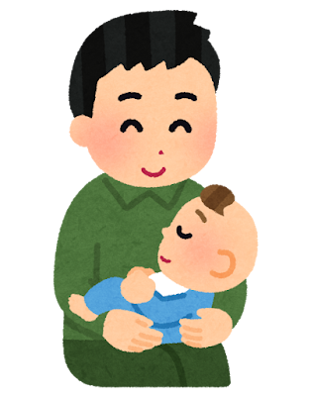
【Question】
These days, Japanese government
encourages more fathers to take
paternity leave.
Notes:
・I have a question to you. These days, Japanese government encourages more father to take paternity leave? But why?
Please talk in pairs for 30 seconds.

Slide 14
【Today’s goal】
「父親の育児休業取得率が上がれば、
社会にどのようなメリットがあるか」
ペアで協力して意見を伝えることができる
（※資料やインターネットの情報も参考にしてよい。）
（話すこと【発表】）
Notes:
【動画の準備をしておく】

Slide 15
Time Table
Warm-up | 【 8 min.】
Activity ① | 【15 min.】
Activity ② | 【13 min.】
Activity ③(Preparation) | 【 9 min.】
Break | 【10 min.】
Activity ③(Preparation) | 【20 min.】
Activity ③(Interaction) | 【15 min.】
Activity ④ | 【15 min.】
Reflection | 【 5 min.】
Notes:
★★★
Warm up 8分
Activity① 15分
Activity② 13分
Preparation 8分
Break 10分
Preparation③20分
Activity③ 15分
Activity④ 15分
Reflection ５分

Slide 16
Get information about childcare leave.
Activity② [Data]
Notes:
Please watch the video and guess what they are talking about.
First, you’ll watch without subtitle. Second time, with subtitle.
一回目を流す。そのあとで、「OK. Let’s talk in pair in English. What is the story about?” ペアで話させる。
二回目を流す。そのあとで、「OK. Let’s share what the story is about. Talk in English.” 途中で、”If you cannot express in English, you may use Japanese.”

Slide 17
［ Data 1］
Gender Gap Index.
big gap
no gap
*The closer the number is to 100, the smaller the gap.
Q: What kind of situation does this data show?
Talk in English in pair.
Notes:
・Also, this is Sweden. If you compare the two, what kind of situation does this data show?
Try to talk in simple English in pair. →生徒に話させる。→少し指名して発表させ、共有する。
教師が→ “Yes, compared with Sweden, Japan has very big gap in Politics, maybe few women in politics.”

Slide 18
［Data 2］
The length of childcare leave fathers took (%)
 | A国 |  | B国
 | Age: 30s | Age: 40s | Age: 30s | Age: 40s
None | 73.8 | 76.9 | 11.5 | 7.0
Less than 2 weeks | 23.0 | 21.4 | 6.7 | 5.5
More than 2 weeks – less than 1 month | 0 | 1.2 | 10.2 | 8.9
More than 1 month – less than 3 months | 2.1 | 0 | 10.1 | 15.7
More than 3 months － less than 6 months | 0 | 0 | 21.3 | 28.1
More than 6 months | 1.1 | 0.5 | 40.2 | 34.8
【A国】
More than 70% of men
didn’t take
parental leave
【B国】
More than 90% of men
took
parental leave
Notes:
From this data, we can see that more than 35% of men took more than 6 months of childcare leave. On the other hand, in Japan, about 76% of fathers didn’t take the leave at all.

Slide 19
Let’s get
More Information!
You can find three more data on Worksheet ①.
Take a close look at Data 3 – Data 5.
You’ll share what you found from them later.

Slide 20
Childbirth and childcare systems
［Data 3］
 |  | A国 | B国
① | Maximum paid leave (per child) ※paid leave= holidays with salary | ・Until the child becomes 1 year old. ・Fathers : 28 days (max.) ― within 8 weeks after birth ― can divide them into 2. | ・About 480 days ※ 90 days ➡only for father ※ 90 days ➡ only for mother ※ 300 days ➡either father or mother can take it
② | Monthly wage during childcare leave | Within 6 months ➡ 67% After 7 months ➡ 50% | Until 13 months ➡ 77.6%
100% = the original salary
Notes:
・日本のシステムは、結構充実している。
・wage = salary (money you get through working) ⇐ 岡山大の英文の中でwageが出るので、ここで使っておきたい。ただ、wageの意味の説明は必要。

Slide 21
■Answer : 87.7% of young people think they want. Men➡84.3% Women➡ 91.4%
［Data 4］
Survey for young people in Japan
■: Do you want to take childcare leave?
出典：厚生労働省 男性の育児休業取得促進事業「若年層における育児休業等取得に関する意識調査（速報値）」
（https://www.mhlw.go.jp/content/001282074.pdf）、P7「育休の取得意向_ご自身」

Slide 22
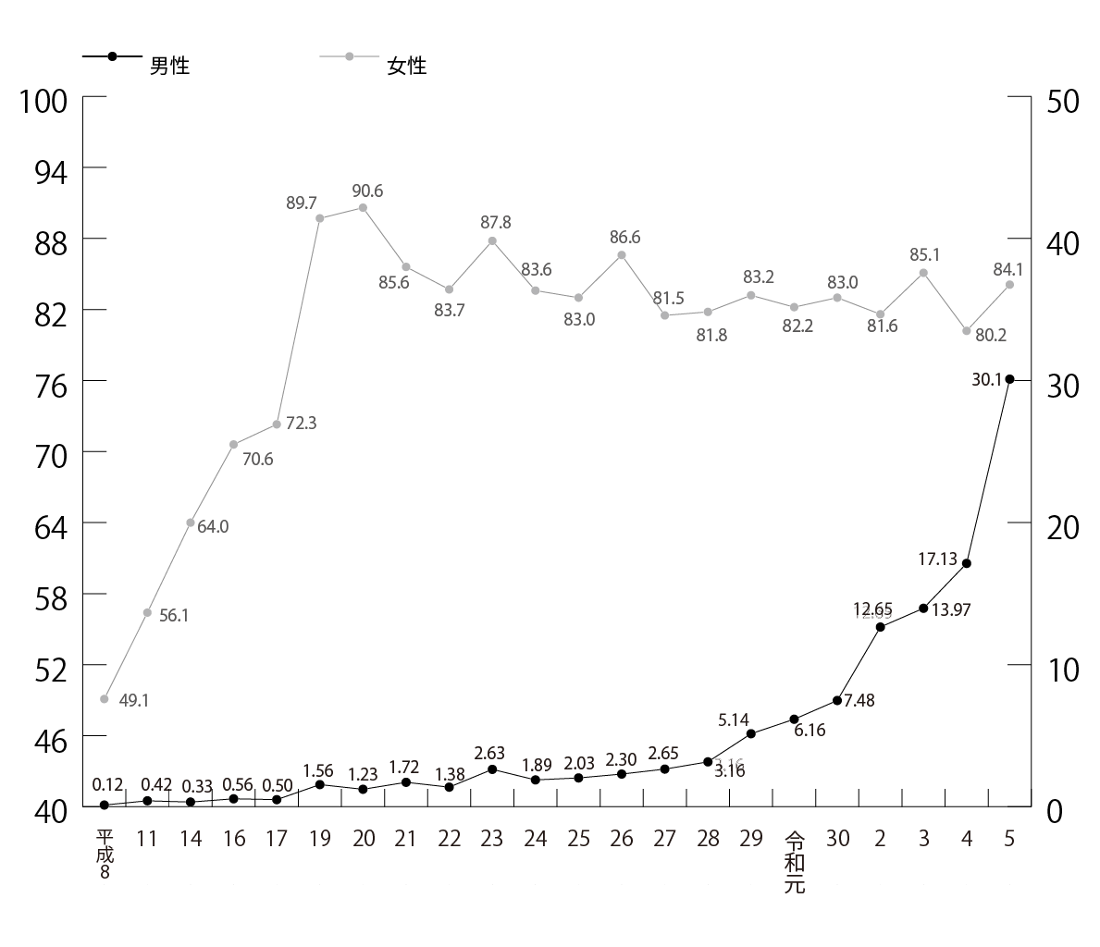
【Women】 about 80%
［Data 5］
The transition of childcare leave acquisition rate
※推移
※取得
【Government’s goal for men】
By 2025➡ 50%
By 2030➡ 85%
【Men】 still low, but a sharp rise（30.1%） in Reiwa 5.
出典：厚生労働省 令和５年度雇用均等基本調査
（https://www.mhlw.go.jp/toukei/list/dl/71-r05/07.pdf）、
P19「 図２ 育児休業取得率の推移」

Slide 23
According to these data…
・Many young people (both men and women)
want to take childcare leaves.
・However, the ratio of taking paternity leave is
still low.
・Our government sets the goal “85% by 2030”.

Slide 24
【Main question for discussion】
If more men take childcare leave, what are good things for society?
(women, children, company…etc)

Slide 25
Time Table
Warm-up | 【 8 min.】
Activity ① | 【15 min.】
Activity ② | 【13 min.】
Activity ③(Preparation) | 【 9 min.】
Break | 【10 min.】
Activity ③(Preparation) | 【20 min.】
Activity ③(Interaction) | 【15 min.】
Activity ④ | 【15 min.】
Reflection | 【 5 min.】

Slide 26
Discussion
Activity③ [Think & Share ideas]

Slide 27
【Main question for discussion】
If more men take childcare leave, what are good things for society?
(women, children, company…etc)

Slide 28
What you are going to do
① Preparation （25 minutes）
★ Pair work
・ Make at least 2 ideas
・ You can use the data & Internet
・ Summarize your ideas on paper
(A3 size)
※ Write only key words!
② Interaction （15 minutes）
★ with other pairs
(3 pairs together)
・ Show A3 paper to the audience
& speak
・ Each pair has 4 minutes
(Presentation + Q&A)
Notes:
Please look at your worksheet, Activity③.
This is what you have to do.
Our theme is “what are good things for society if more men take childcare leave?”
1st, you have 25 minutes to prepare. You prepare in pair. You need to cooperate together.
2nd, you’ll have interaction with other pairs for 15 min. We put 3 pairs together.
O.K., then 右側の項目を一つずつアニメーションで出しながら、
・Please make at least 2 ideas.
・You can use the data & Internet. You can, but you don’t have to.
・And summarize your ideas on A3 paper. Write only keywords.
・When doing presentation, please show the paper to the audience.
・Each pair has 4 min.

Slide 29
What to speak
Your idea + Reason / the result of that
e.g.)
If more men take parental leave,
① that is good for children because ～.
or ② that is good for children in two ways.
First, ～. Second, ～.
or ③ children can ～. Then（そうすれば）～
Notes:
【このスライドの途中まで、藤井先生の担当】
Please look at your worksheet here. This is an example to make your ideas.
For example, と言って、上の例文を読み上げる。※orのところを強調する。
Try to make as simple English as possible. ※この部分も強調して言う。
You have 25 minutes to prepare. And the last 5 minutes, please practice presenting with your partner.
Before the 10 min. break, we have 5 minute to prepare. So please talk with your pair.
5分後、Now everybody let’ have 10 minutes break. Please come back by .と言って時間を伝える。

Slide 30
10 min. break

Slide 31
Time Table
Warm-up | 【 8 min.】
Activity ① | 【15 min.】
Activity ② | 【13 min.】
Activity ③(Preparation) | 【 9 min.】
Break | 【10 min.】
Activity ③(Preparation) | 【20 min.】
Activity ③(Interaction) | 【15 min.】
Activity ④ | 【15 min.】
Reflection | 【 5 min.】

Slide 32
What to speak
Your idea + Reason / the result of that
e.g.)
If more men take parental leave,
① that is good for children because ～.
or ② that is good for children in two ways.
First, ～. Second, ～.
or ③ children can ～. Then（そうすれば）～
Notes:
【ここから中村の担当】
Now everybody, welcome back. So you have 20 minutes for preparation. And the last 5 min. please practice for presentation.
ここで、If you have any question, please ask either of us.
Are you ready? Start!と言って、タイマーも20分にセットし、生徒が見えるようにしておく。
【20分間：準備時間】
生徒は準備作業に取りかかる。教師は机間巡視を行い、適宜、アドバイスや質問に応じる。
共通した質問があれば、全体へ伝えることも行う。生徒の作業中は、スライドの28番目を前に映しておく。
【20分間のうちの最後の5分前になったら、】
Now you have 5 minutes left. Please practice speaking for presentation.と声かけをする。
【5分後】Now time is up. と言って次のスライドを映し、プレゼン時の注意事項を伝える。

Slide 33
Speaking (with other pairs)
Interact with the other pairs in 4 min.
Rules:
● clear and big voice
● eye contact (× talk to paper)
● Keep talking in groups for 4 min.
(Give questions!!)
Notes:
When you present, there are some rules.
Speak in a clear and big voice. Your audience should understand what you’re saying.
Second, eye contact. Do not read the paper.
Third, during 4 minutes, try to keep talking. So everybody should cooperate.
We use the timer to count 4min.
Now please make group like this. You are now seated like this.と言って33のスライドを見せる。Then move like this.と言って、34枚目のスライドを見せる。生徒が、理解したことを確認する。Now make the group of 6. と指示をしてから、生徒が移動するのを待つ。
【移動が終わったら、スライド32番をずっと見せておく】
Are you ready for the discussion?と言ってから、時間を４分ずつ図り、区切っていく。 全部終わったら、
OK. Everybody, time is up. Please return to your seat and move your desks to the original position.
How was the discussion? と言って、私が総括する。 I hear presenters 「 」、audience 「 」. So you tried really hard. Let’s give everybody big hands.皆で拍手。
それが終わったら、let’s check some more data which may help you understand more. と言った後、スライド35に移動。
【ここは言い方が難しいのでどうするか？】
※ When asking question, if possible, after 1st question, please ask them about their answers.
・Please ask the related question. For example, If more Japanese speak English, the Japanese economy will get better. Because many foreign people can visit easily. This will help the economy get better. ➡時間をみながら。時間がなければ省く。

Slide 34
Front White Board
1
2
A1 A2
3
C1 C2
2
3
E1 E2
B1 B2
1
D1 D2
F1 F2
1
2
G1 G2
3
I1 I2
H1 H2
1
J1 J2
1
2
K1 K2
2
3
M1 M2
1
2
O1 O2
L1 L2
N1 N2
P1 P2
3
Q1 Q2
3
S1 S2
1
R1 R2
2
T1 T2
3
4
U1 U2
【Groups】
・same color➡same group
・red number➡presentation order
V1 V2

Slide 35
Front White Board
1
2
A1 A2
C1
C2
D1
D2
E1 E2
2
3
3
1
B1 B2
F1 F2
1
2
G1 G2
I1
I2
3
H1 H2
K1 K2
1
2
1
2
O1 O2
3
Q1
Q2
S1
S2
3
L1 L2
2
3
M1 M2
J1
J2
P1 P2
N1 N2
1
※欠席が出たと聞いたので、当日の朝、調整する。
【Groups】
・same color
➡same group
・red number
➡presentation order
3
R1
R2
U1 U2
T1
T2
1
2
V1 V2
4

Slide 36
Speaking (with other pairs)
Interact with the other pairs in 4 min.
Rules:
● clear and big voice
● eye contact (× talk to paper)
● Keep talking in groups for 4 min.
(Give questions!!)
Notes:
When you present, there are some rules.
Speak in a clear and big voice. Your audience should understand what you’re saying.
Second, eye contact. Do not read the paper.
Third, during 4 minutes, try to keep talking. So everybody should cooperate.
【ここは言い方が難しいのでどうするか？】
※ When asking question, if possible, after 1st question, please ask them about their answers.
・Please ask the related question. For example, If more Japanese speak English, the Japanese economy will get better. Because many foreign people can visit easily. This will help the economy get better. ➡時間をみながら。時間がなければ省く。
We use the timer to count 4min.
Now please make group like this. と言ったら、座席移動した後のスライドを見せる。（※この方が移動後のイメージがし易いから。）
時間を４分ずつ図り、区切っていく。 全部終わったら、
OK. Everybody, time is up. Please return to your seat and move your desks to the original position.
How was the discussion? と言って、私が総括する。 I hear presenters 「 」、audience 「 」. So you tried really hard. Let’s give everybody big hands.皆で拍手。
それが終わったら、let’s check more data which may help you understand the issue more. と言った後、スライド36に移動。

Slide 37
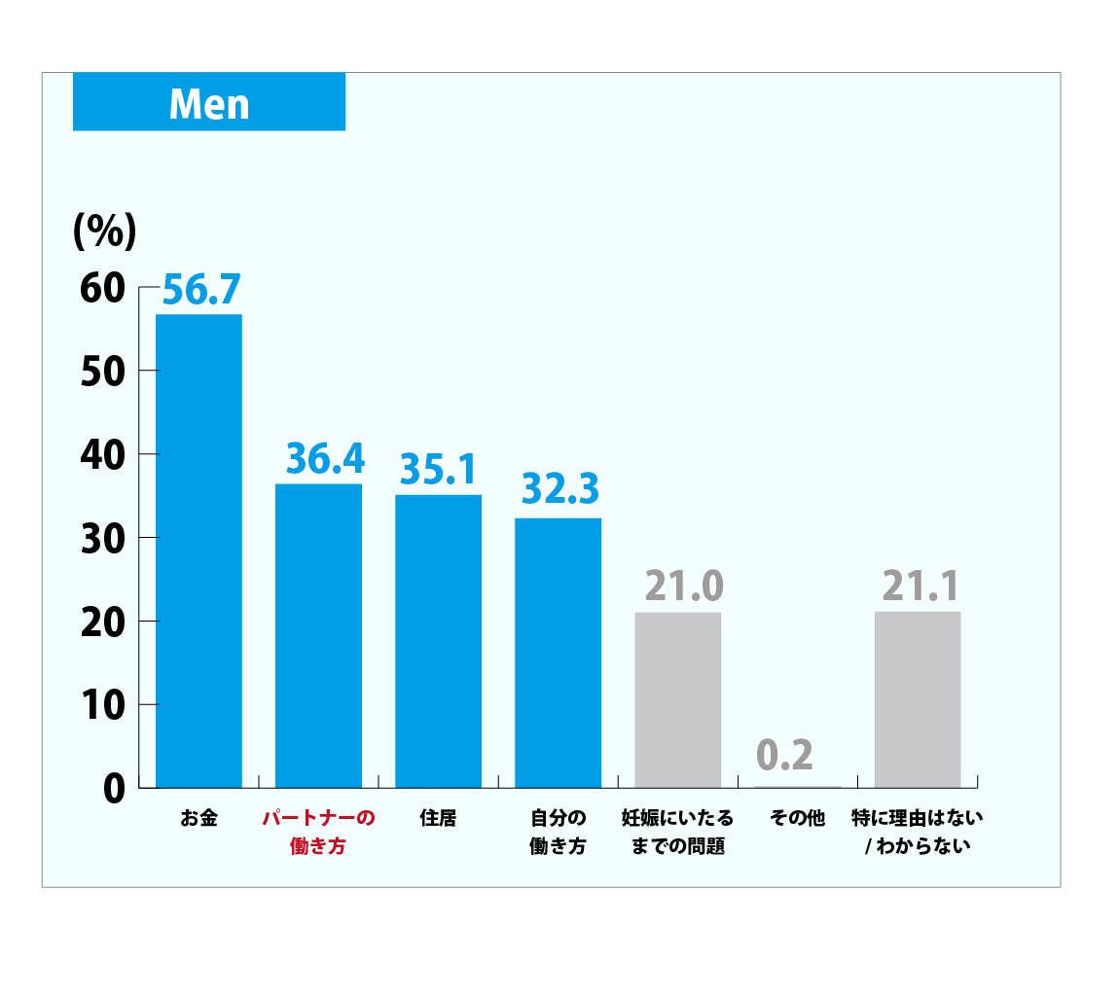
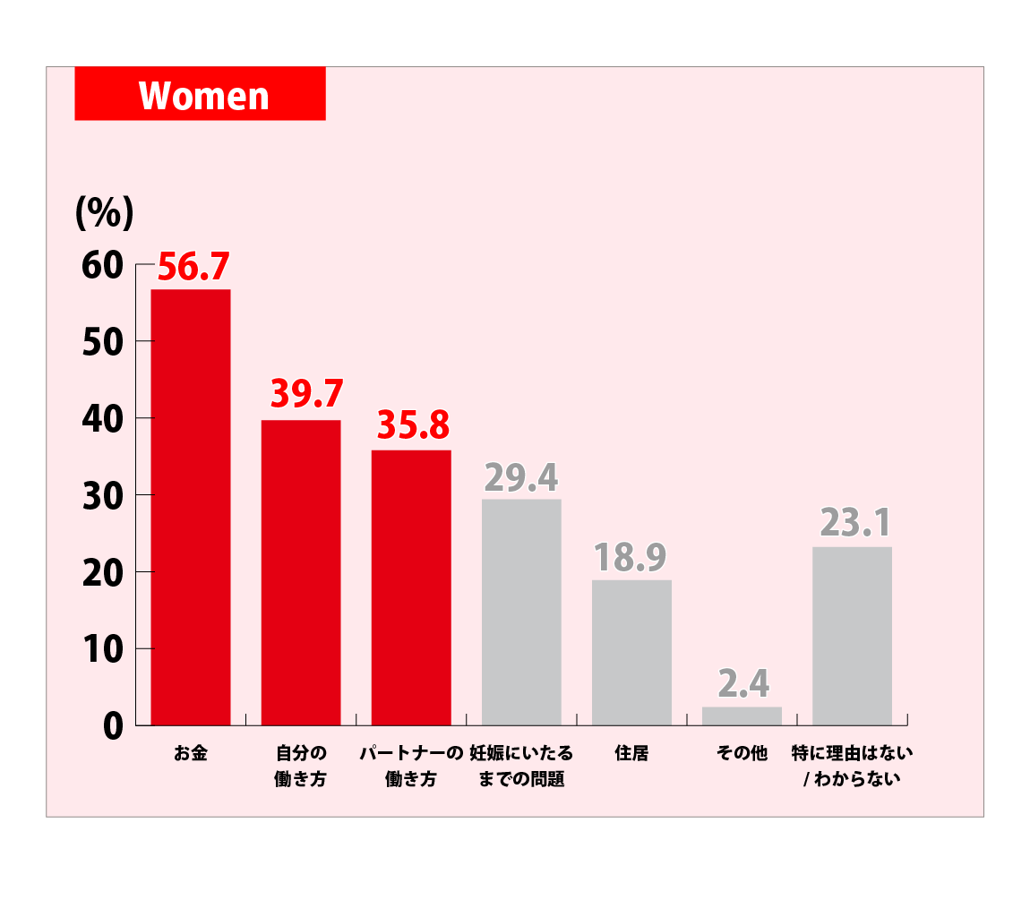
Both men and women worry about how their partner will work when they have a baby.
［Data 6］
出産・子育てについて感じているハードル
How I work
How my partner works
How my partner works
出典：厚生労働省 男性の育児休業取得促進事業「若年層における育児休業等取得に関する意識調査（速報値）」
（https://www.mhlw.go.jp/content/001282074.pdf）、P22「子育てのハードル」
Notes:
This is the difficulties that young people feel for having a child.
You can tell “Both men and women worry about how their partner will work when they have a baby.”

Slide 38
［ Data 7］
The transition of long working hours ratio
（％）
※推移
 |  | ２０１５ | ２０１６ | ２０１７ | ２０１８ | ２０１９
men & women | A国 | 20.7 | 20.2 | 20.2 | 19.2 | 18.5
 | B国 | 7.5 | 7.0 | 6.9 | 6.8 | 6.6
Men | A国 | ２9.6 | 28.8 | 29.7 | 27.0 | 26.4
 | B国 | 10.8 | 9.8 | 9.6 | 8.9 | 8.7
Women | A国 | 9.5 | 9.0 | 9.5 | 8.4 | 8.2
 | B国 | 4.6 | 4.0 | 3.8 | 3.6 | 4.0
unit : ％
Notes:
・This shows the change of long working hours ratio, between Japan and Sweden, and men and women.
You can see Japanese people, especially men, tend to work much longer hours than Swedish people.
Maybe we, Japanese have some problems of how we work. （※howのところを強調して言う。）
So when you think about today’s theme, it’s better to see the issue from various points of view.

Slide 39
Time Table
Warm-up | 【 8 min.】
Activity ① | 【15 min.】
Activity ② | 【13 min.】
Activity ③(Preparation) | 【 9 min.】
Break | 【10 min.】
Activity ③(Preparation) | 【20 min.】
Activity ③（Discussion） | 【15 min.】
Activity ④ | 【15 min.】
Reflection | 【 5 min.】
Notes:
OK, now, we’re nearly there.
The final activity.と言って次のスライドに移動。

Slide 40
Reading (12 min.)
Try to work on
an Long Passage Comprehension
・7 min. to read and answer
・5 min. to explain
Notes:
I want you to work on an long passage comprehension.
You have 7 minutes to read and answer.
After that, I will explain the answer in 5 min.
If it is difficult to finish answering, maybe you can check and underline where you think the answer is.
と言って、ここで、問題を配布する。
So you have 7 minutes.時間計測開始。 →6分ころになって終わっていなそうであれば、You have 3 more minutes.と言って時間を３分追加する。
10分経過したら、OK you time is up.
I’ll explain now.

Slide 41
1段落 The ambassador of B Country encourages more fathers in A Country to take advantage of the country's "very good" parental leave system and devote themselves to childcare. He believes that actively participating in childcare can lead to better performance in the workplace. Having taken parental leave himself, he suggests that independent caregiving, based on mutual trust and close communication with the mother, may be key to a fulfilling childcare experience.
Notes:
“an experience would lead them to becoming better workers back at the office.”, this part is related to the answer.
But the answer is not here.

Slide 42
2段落 While more than 90% of fathers in Country B take parental leave, the ambassador was surprised to learn that similarly few men take parental leave in Country A. In Country A, both men and women can retain approximately 70% of their monthly salary until 180 days from the start of parental leave and 50% after 181 days until the child turns one year old. Under certain conditions, extensions are allowed until the child turns 2 years old. According to a report by an international organization, Country A offers the longest parental leave (about 30 weeks) among 41 upper-middle income countries. However, although the government has set a goal of increasing the rate of men taking parental leave in the private sector to about 15% in the future and to 30% in a few years, the rate a few years ago was about 7%, well below the target.
Notes:
Here, green underlined parts, you already know the information from today’s lesson. For example, In Japan people can get 67% of salary for the first half a year.
Japan sets the goal, 30 % by 2025.

Slide 43
3段落The ambassador said that during his parental leave, he and his wife discussed everything and helped each other, but she never told him what to do. She never told me what to do, what to cook, how to spend my day. It was my responsibility. I felt the same way when she was home. He stresses that parenting requires a lot of communication and trust.
4段落In country B, each child is entitled to 480 days of leave, but one parent cannot take all of them alone; of the 480 days, 90 are reserved for the father. Although this period is shorter than for mothers, the Ambassador noted that fathers take more than 90% of their parental leave.
Notes:
Here, also, In Sweden, parents have 480 days of parental leave. 90 days are only for father.

Slide 44
5段落 The ambassador is convinced that workers who have experienced childcare are better leaders. 'I believe that men who have experienced childcare make better bosses. Why? Because they need to think in new and creative ways,” he says. 'There is no manual for child care. You need to be flexible, come up with new ideas, and adjust your plans. These are all very important skills, both at work and in our personal lives.”
6段落 Smiling, he adds, “Taking care of a child is harder than being an ambassador for country B.”
Notes:
This is where the answer is. The author asks why? And then answers because. と言って赤線部分を早口で読み上げる。

Slide 45
Q1. 育児休暇を経験した父親は、なぜ良い上司になりうるのでしょうか？
【模範解答】
育児は独創的な方法で考えなければならず、マニュアルはない。柔軟性を持ち、新しいアイデアを出し、計画を調整する必要がある。これらはすべて、仕事でも私生活でも非常に重要なスキルになるため。

Slide 46
Time Table
Warm-up | 【 8 min.】
Activity ① | 【15 min.】
Activity ② | 【13 min.】
Activity ③(Preparation) | 【 9 min.】
Break | 【10 min.】
Activity ③(Preparation) | 【20 min.】
Activity ③(Interaction) | 【15 min.】
Activity ④ | 【15 min.】
Reflection | 【 5 min.】

Slide 47
In conclusion
What do you want your future to be?
You’re always free to make any choice.
“You only live once. Have a great life
with passion in your heart.”
Notes:
第３回のプログラムどうでしたか？
今日は、ちょっと難しい社会的な問題で、データにもたくさん目を通しましたし、ディスカッションも簡単ではなかったかもしれません。
しかし、前半に入れた背景知識がありましたので、少しは、 読みやすかったと思います。
やはり、背景知識って大切です。また、単語力があれば、背景知識が少なくても、大学入試問題でも、結構読めますよ。
また、私は、失敗をした時が、人間が一番、学ぶと思うんです。
これからも色んな試練などもあると思いますが、それも全て、自分を成長させて、人生を豊かなものにしてくれるスパイスだと思って、すてきな人生をデザインして下さい。
What do you want your future to be?”
You are always free to make any choice, you can get married or single, you can have children, or no children.
You can try anything.
Your life is only once. So I want you to have a great life with passion（と言いながら、こぶしで胸をたたくジェスチャーをする。）in your heart.
Thank you for coming today!

