Slide 1
第２回 教科探究特別プログラム （英語）
２０２４/１0/19
大分県教育センター

Slide 2
Today, we are going to ...
1. do an activity for warming up
[10 mins]
2. read an article and summarize it
[40 mins]
3. speak and write about the article
[50 mins]

Slide 3
Word Quiz
What is the meaning of “bicycle-friendly?”
① 乗りやすい自転車
② 自転車に優しい
③ 自転車友達

Slide 4
Word Quiz
What is the meaning of “bicycle-friendly?”
① 乗りやすい自転車
② 自転車に優しい
③ 自転車友達

Slide 5
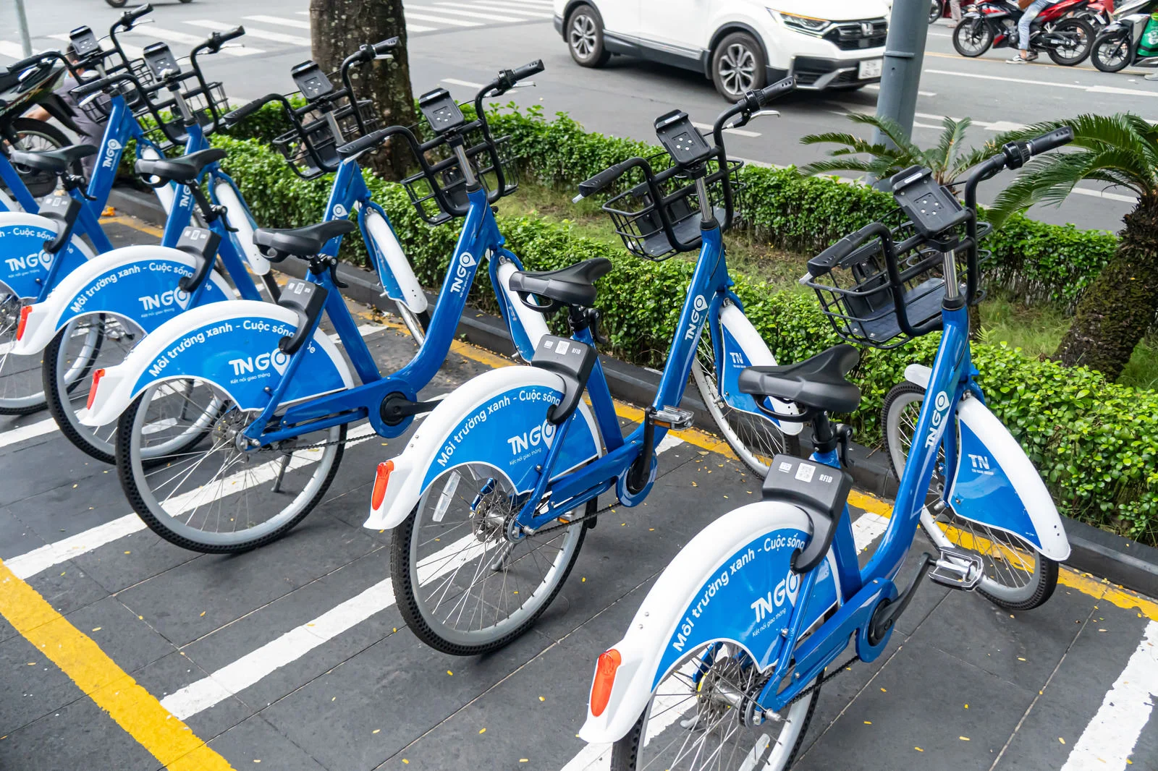
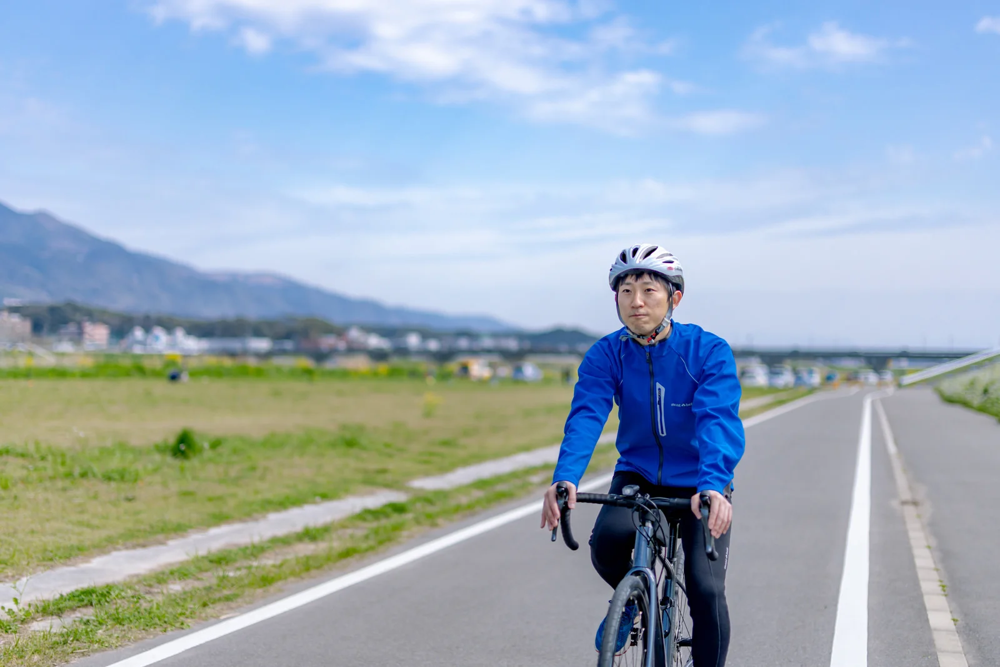
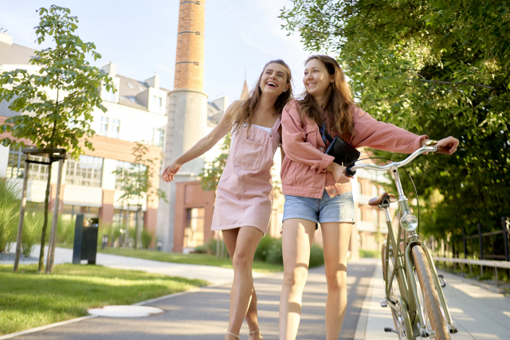
What kind of city is “bicycle-friendly?”
Give some examples.

Slide 6
Word Quiz
What is the meaning of “eco-friendly?”
① エコひいきする
② イイ子に優しい
③ 環境に優しい

Slide 7
Word Quiz
What is the meaning of “eco-friendly?”
① エコひいきする
② イイ子に優しい
③ 環境に優しい

Slide 8
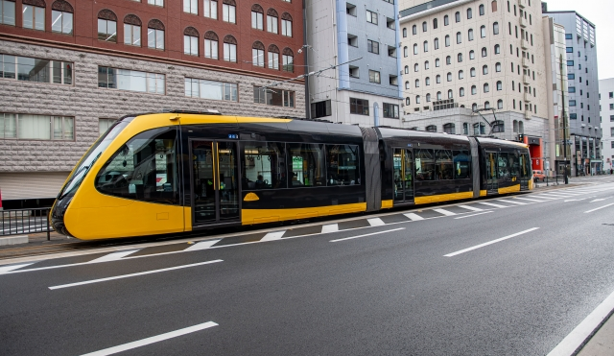
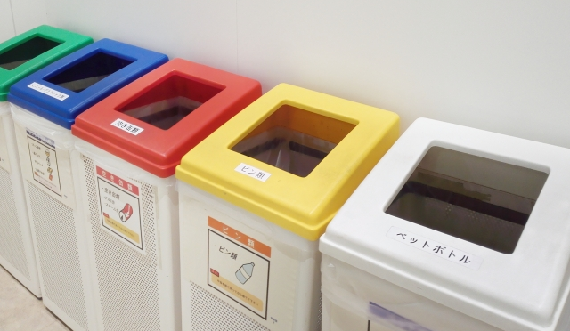
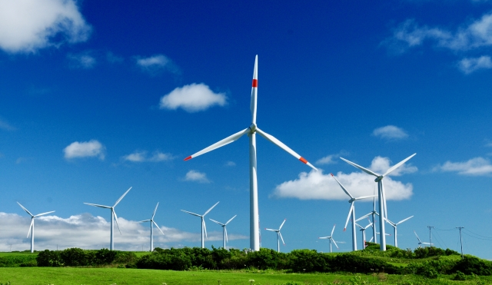
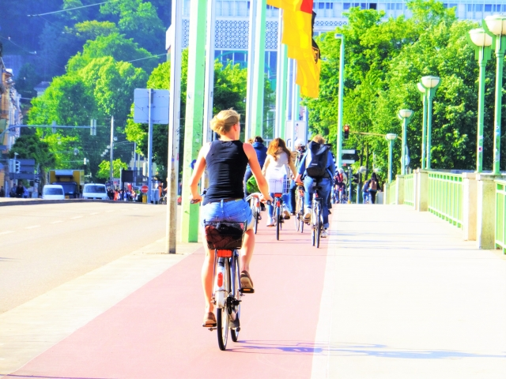
What kind of lifestyle is “eco-friendly?”
Give some examples.

Slide 9
Word Quiz
Create some new words using “-friendly”.
Examples:
・User-friendly: 使いやすい
・Pet-friendly: ペットに優しい、ペット同伴可能
・Family-friendly: 家族向けの
・Kid-friendly: 子供向けの、子供に優しい
・Health-friendly: 健康に良い
・Beginner-friendly: 初心者に優しい、初心者向けの

Slide 10
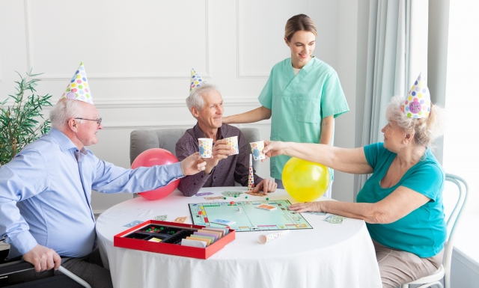
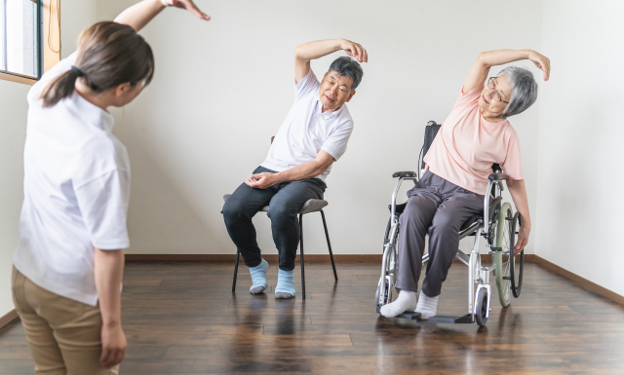
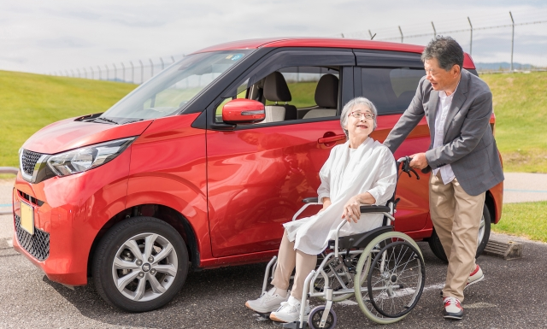
When you hear “age-friendly community,” what do you think of?

Slide 11
Read an article and summarize it!
Step 1
全文を読んで、概要を理解しよう
(5 mins)

Slide 12
Question
Does the author think the “age-friendly community” is good only for elderly people?
Yes or No

Slide 13
Read an article and summarize it!
Step 2
段落ごとに読んで、正確に理解しよう

Slide 14
The Age-Friendly Communities movement began with the rapid growth in the number of older adults. While there are many different ideas about what constitutes an “age-friendly community,” most agree that it is important to strengthen social ties and to be inclusive of people of all ages. For example, at one international conference, the participants agreed that “a society that includes people of all ages . It does not separate youth, adults, and the elderly. Instead, it unites them so that they can understand and work toward the same goals.”
1

Slide 15
Question 1-①
Why did the age-friendly community movement start?
A: because of the rapid growth in the number of older people.
(高齢者の数が急速に増えてきているから）

Slide 16
Question 1-②
What is an important goal of an age-friendly community?
A: An important goal is to strengthen social ties and to be inclusive of people of all ages.
(社会的な結びつきを強め、あらゆる年齢層の人々を受け入れることが重要な目標である）

Slide 17
Question 1-③
What did participants at an international conference say about age-friendly societies?
A: They said that an age-friendly society includes people of all ages. It does not separate youth, adults, and the elderly. Instead, it unites them so that they can understand and work toward the same goals.（年齢に優しい社会は、あらゆる年齢層の人々を含み、同じ目標に向かって団結することである）

Slide 18
Question 1-④
How does an age-friendly community treat different age groups?
A: It does not separate youth, adults, and the elderly but unites them.
(青少年、成人、高齢者を分離せず、一体化させる）

Slide 19
The international organization explains that aging happens as long as we live. 'We all age at every moment of our lives. So we should have ways to age in healthy and active ways,” they say. The international organization believes that people of all ages should invest in staying healthy so that older people can live their best lives.
2

Slide 20
Question 2-①
What does international organizations say about aging?
A: They say that aging happens as long as we live and that we all age at every moment of our lives (老化は生きている限り起こることであり、私たちは皆、人生のどの瞬間にも老化していると言っている。）

Slide 21
Question 2-②
What do international organizations tell us to do for staying healthy as we age?
A: They tell us to invest in staying healthy and find ways to age in a healthy and active manner.
(健康でいるために投資し、健康で活動的に年を重ねる方法を見つけなさいと言っている）

Slide 22
In real life, however, the Age Friendly Communities movement is mostly focused on the needs and interests of older adults, their caregivers, and the people they serve. As a result, they have not been able to gather enough information from young people and their families about what makes a community a good place to live and how they can work with the elderly.
3

Slide 23
Question 3-①
What has the age-friendly community movement mostly focused on?
A: It has mostly focused on the needs and interests of older adults, their caregivers, and service providers.
(高齢者やその介護者、介護サービス提供業者の必要や利益に主に焦点を当ててきた）

Slide 24
Question 3-②
What has the age-friendly movement not done so far?
A: It has not collected enough information from young people and their families about what makes a community a good place to live and how they can work with the elderly.
(若者やその家族から、何が住みやすい地域なのか、どうすれば高齢者と協力できるのかについて、十分な情報を集めていない）

Slide 25
4 One reason for the gap between ideal and reality may be that people believe that what is good for the elderly is good for everyone. In other words, it is believed that if a community is good for the elderly, it must be good for all generations. While there are many things that each generation has in common, one new study shows that the habits and attitudes of the young and the elderly are very different. According to these studies, to truly understand what makes a city livable for all generations, we need to gather information from all generations about what makes a city livable for both young and old.

Slide 26
Question 4-①
Why is there a difference between the idea and the reality of an age-friendly community?
A: Because people assume that what is good for the elderly is good for everyone, but in reality, different generations have different needs and preferences.
(高齢者にとって良いことは誰にとっても良いことだと思われているが、実際には世代によってニーズや好みが異なるから）

Slide 27
Question 4-②
How do the habits and attitudes of the young and the elderly differ according to the studies mentioned?
A: The habits and attitudes of the young and the elderly are very different.
(若者と高齢者の習慣や態度は大きく異なる）

Slide 28
Question 4-③
What does the passage suggest is necessary to create livable cities for all generations?
A: It is necessary to gather information from all generations to understand what makes a city good for both young and old people.
(若者、高齢者の両者にとっていい町とは何かを理解するために、全ての世代から情報を集める必要がある）

Slide 29
Read an article and summarize it!
Step 3
要約するために、英文の内容を整理してみよう

Slide 30
A: 日本語で簡単にまとめてみよう
＜英文全体のテーマ＞
（ ）について
＜筆者の主張＞
〇理想：（ ）
〇現実：（ ）
〇原因：（
）
〇解決策：（ ）
真に “age-friendlyな”社会とは
全年齢層を考慮に入れた社会
高齢者に焦点を当てた社会になっている
高齢者にとって良いものは、
誰にとっても良いという思い込み
複数の世代からデータを集める（意見を募る）こと

Slide 31
B: 英語で簡単にまとめてみよう
☆Theme of the entire text：
About（ ）
☆Author’s opinion：
〇Ideal：（ ）
〇Reality：（ ）
〇Cause：（
）
〇Solution：
( ）
a truly “age-friendly” society
Society friendly to all age groups
Society focused only on elderly people
People think that what is good for
elderly people is good for everyone
Gather information from all generations

Slide 32
Read an article and summarize it!
Step 4
STEP 3のまとめを参考に、英語で要約文を作ってみよう

Slide 33
【解答例】
To realize a truly age-friendly society, we should create a society that is friendly to all ages, but in reality the focus is on elderly people, because we often think that a society that is good for the elderly is good for everyone. Different generations have different ideas, so the opinions of all generations should be gathered.

Slide 34
10-minute break

Slide 35
This Term’s Goal Age-friendlyな社会にするために 何ができるのか 自分の考えを述べることができる。
What can we do
to make our community age-friendly?

Slide 36
WARM-UP PICTURE DESCRIBING

Slide 37
PICTURE DESCRIBING 1) ROCK-PAPER-SCISSORS 2) Winner → describe Loser → turn around and answer 3) 30 seconds

Slide 38
EXAMPLE COFFEE

Slide 39
Ready
PICTURE DESCRIBING 1

Slide 40
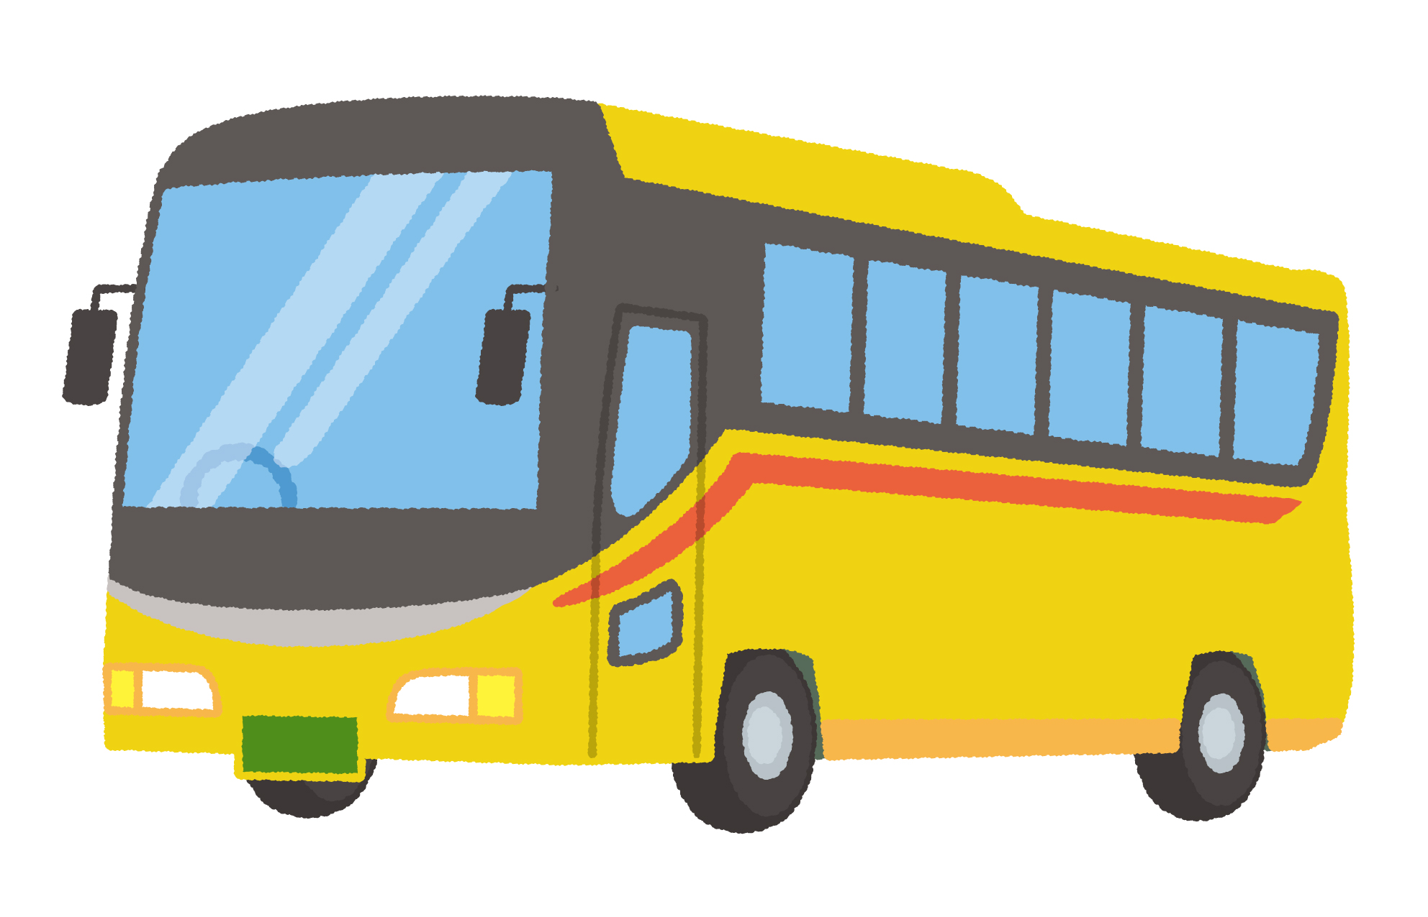
BUS
30 sec

Slide 41
STOP

Slide 42
Ready
PICTURE DESCRIBING 2

Slide 43
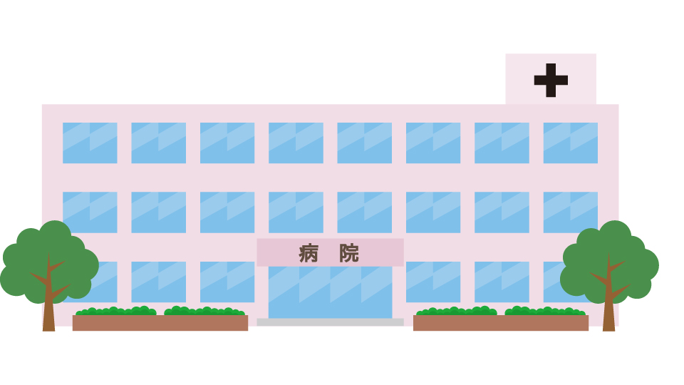
HOSPITAL
30 sec

Slide 44
STOP

Slide 45
MENU
1. RETELLING ＋1
2. SPEECH
3. WRITING

Slide 46
RETELLING＋1
自分の意見・感想を加えて 1分間 リテリングする。
あなたは留学先の学校で
The age-friendly communityについて学びました。
ホストファミリーに
授業で学んだことと、あなた自身の考えを伝えます。

Slide 47
STEP 1 READING PRACTICE

Slide 48
STEP 1 READING PRACTICE 1) OVERLAPPING 2) READING TWICE

Slide 49
STEP 2 MAPPING 3-min

Slide 50
MAPPING for 1-min retelling Rules 1) NO SENTENCES. DON’T COPY THE PASSAGE. Ex. “it is important to make strong social connections and include people of all ages.” 2) Can add 2 or 3 more keywords. 3) Make your own opinion, using ‘in my opinion, …’
Social connections

Slide 51
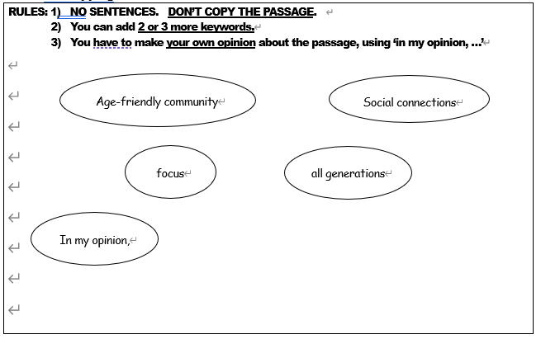
Mapping

Slide 52
Ready
MAPPING

Slide 53
MAPPING
1) NO SENTENCES. 2) Add 2 or 3 more keywords. 3) Make your own opinion.
3 minutes

Slide 54
STOP

Slide 55
STEP 3 PRACTICE 3-min

Slide 56
1-min retelling
WPM ・・・ WORDS PER MINUTES（単語数/1分）
・共通テスト READING ・・・ 150 WPM
LISTENING ・・・ 130 WPM
・「すらすら」な会話 ・・・ 130 WPM
・ネイティブの会話 ・・・ 160 ～ 200 WPM
・高校生平均（SPEAKING） ・・・ 70 WPM
GOAL: MORE THAN 70 WPM

Slide 57
PRACTICE 3 minutes SPEAK ALOUD with your map

Slide 58
Ready
PRACTICE

Slide 59
PRACTICE
with your map
3 minutes

Slide 60
STOP

Slide 61
STEP 4 RETELLING＋1

Slide 62
RULES
Stand up.
2) Winners → Retelling
LOSERS → Count the words
After the speech, you can sit down.
Switch the role.
★ KEEP EYE CONTACT

Slide 63
Ready
RETETTLING＋1

Slide 64
RETELLING＋1
EYE CONTACT
OVER 70 WPM
1 minute

Slide 65
STOP

Slide 66
SWITCH

Slide 67
SHARING in class

Slide 68
MISSION
Is what is good for older people
really good for all generations?

Slide 69
Is what is good for older people really good for all generations?
STEP 1 Ideas for the speech
・Age-friendly communityは、どのような社会？
・思いつくかぎり、キーワードを書きましょう。

Slide 70
STEP 1 Ideas for the speech
・Age-friendly communityとは、どのような社会？
Infrastracture
- Wide sidewalks
Healthcare
- hospitals
Public transportation
- free of charge

Slide 71
Is what is good for older people really good for all generations?
STEP 1 Ideas for the speech
・Age-friendly communityは、どのような社会？
・思いつくかぎり、キーワードを書きましょう。
3 minutes

Slide 72
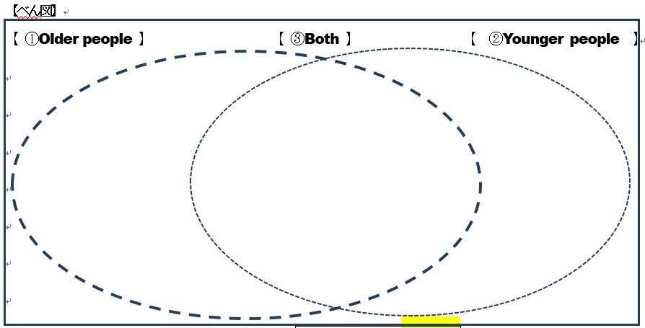
STEP1 Ideas for the speech
(2) べん図に仕分けしよう。

Slide 73
STEP1 Ideas for the speech
(2) べん図に仕分けしよう。
Older Only
Younger Only
Both
2 minutes
Public
transportation
- free of charge
Infrastracture
- Wide sidewalks
Healthcare
- Many hospitals

Slide 74
STEP 2 PRACTICE 3-min

Slide 75
Ready
PRACTICE

Slide 76
PRACTICE
with your map
3 minutes

Slide 77
STOP

Slide 78
STEP 3
SPEECH
Topic:
Is what is good for older people
really good for all generations?

Slide 79
Ready
EYE CONTACT

Slide 80
SPEECH
TOPIC:
Is what is good for older people
really good for all generations?
1 minute

Slide 81
STOP

Slide 82
SWITCH

Slide 83
SHARING in class

Slide 84
WRITING
NEW TOPIC

Slide 85
WRITING
What can we do
to make our community
age-friendly?

Slide 86
WRITINGするときは・・・
Introduction
Introduction
Reason 1 and Support
BODY
Reason 2 and Support
Reason 3 and Support
Conclusion
Conclusion

Slide 87
Ready
5 minutes

Slide 88
5-min WRITING
What can we do
to make our community age-friendly?
5 minutes

Slide 89
STOP

Slide 90
SHARING in class

Slide 91
Today’s Reflection
・たくさんの英語にふれよう。
・ 読んだ英文を音読 (Intake)しよう。
・ 自分の考えを英語で話す習慣を。
Slow and steady wins the race!

