Slide 1
We are Trainers
教科探求プログラム 1回目 1年英語
Naoki Fukuda from Oita Tsurusaki High School
Masahiko Morisaki from Oita Uenogaoka High School.
We are happy to train you!

Slide 2
Rule for pair-work
A
Left
B
Right
Respect
your pair.
C
（ ）

Slide 3
①Nodding to show that you understand. ②When teachers ask you some questions or show some model, try your best!

Slide 4
Quick Self-Introduction
①Your name
②Your school

Slide 5
Warm- up activity
What is the word I’m going to explain??

Slide 7
It‘s your turn!
A: Explain the picture without using “that word”.
B: Say that word.

Slide 10
America

Slide 11
Education

Slide 12
Today’s goal : Expressing It in Your Own Words （自分の言葉（英語）で表現できるようになろう）

Slide 13
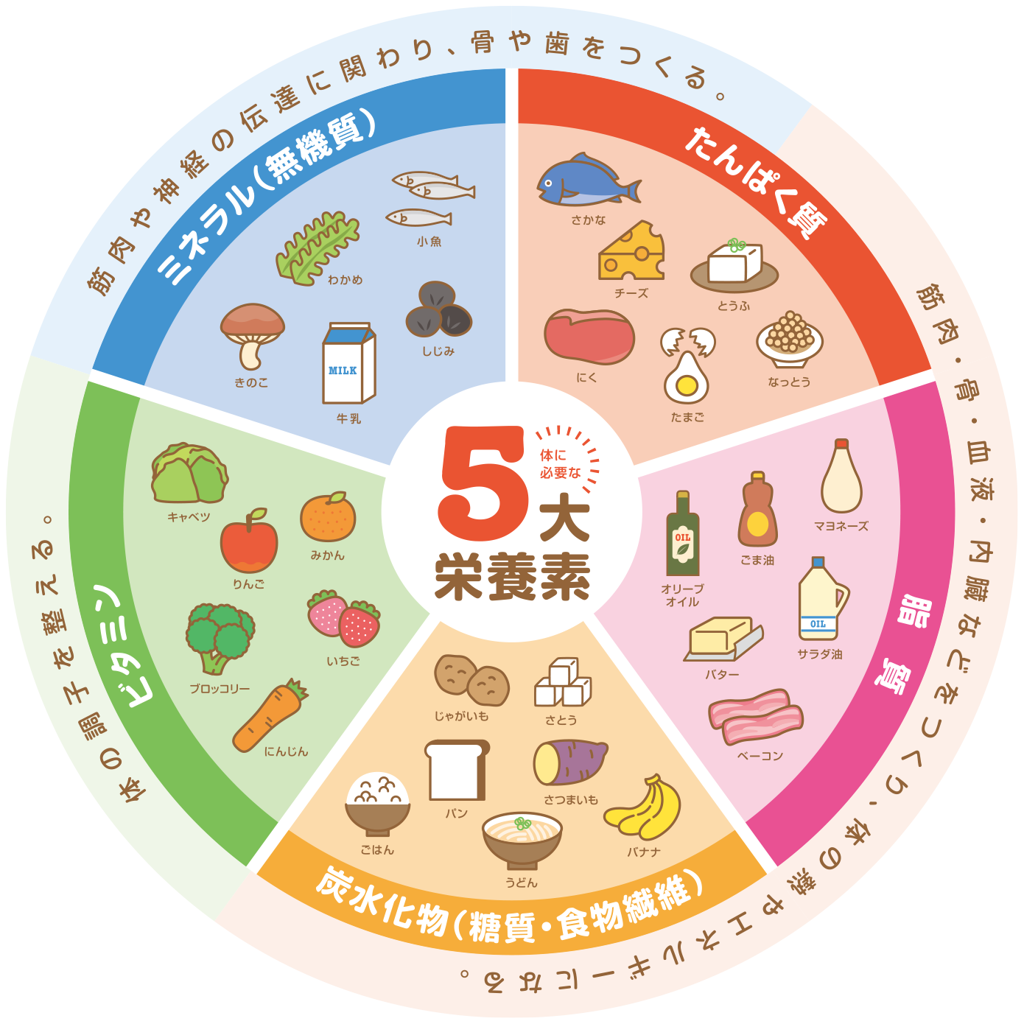
Today’s goal : EIYOW (えいようactivity) （自分の言葉 （英語）で表現できるようになろう）

Slide 14
Today’s material :

Slide 15
Today’s material : Speech from the President of a Country

Slide 16
My Education
My Future
Speech from the President of a Country
to High School Students

Slide 17
We are going to understand What messages the President wants to give to high school students, doing EIYOW.

Slide 18
Every single one of you has something that you’re good at. Every single one of you has something to offer. And you have a responsibility to yourself to discover what that is.

Slide 19
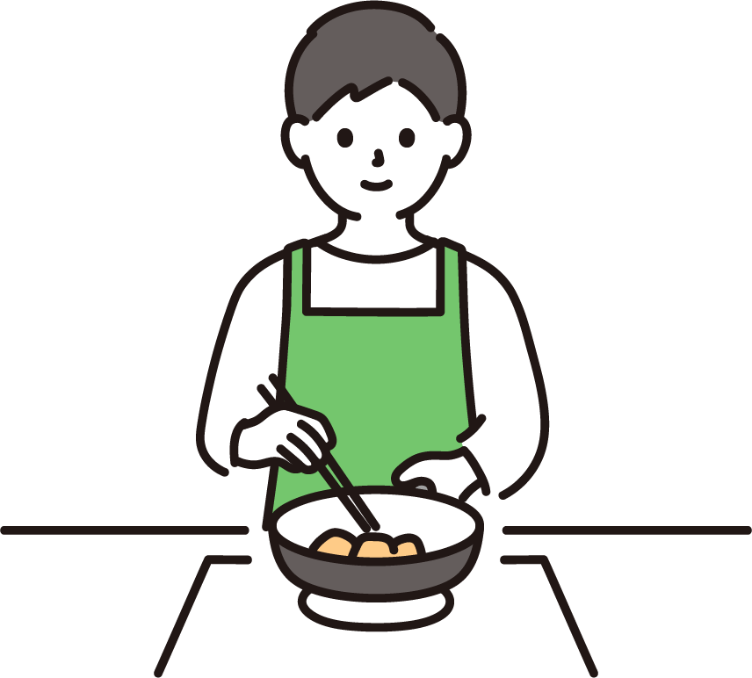
Question①
What are you good at?
Tell what you are good at
to your pair!

Slide 20
Question!②
When you were a kid, what did you want?
Do you remember?
Talk with your pairs.

Slide 21
picture①

Slide 22
TRY EIYOW!①
You =
Showing the picture①, explain your childhood story, doing EIYOW.

Slide 23
TRY EIYOW!①
Read the following passage and practice for 2 min!
My father left home when I was two years old, and my mother raised me by herself. She worked hard, but it was tough to pay the bills, and she couldn’t always give me the things other kids had.

Slide 24
EIYOW Reproduction example
His father left home when he was two years old, and didn’t come back. So, His mother didn’t have much money and couldn’t give He what he wanted, for example, toys or video games.

Slide 25
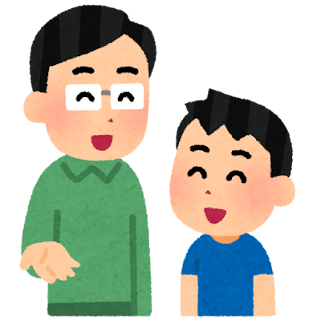
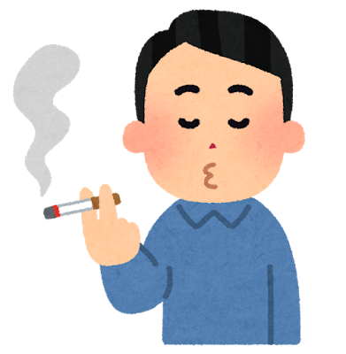
But・・・

Slide 26
Question!③
Read the following passage
I got many chances to study in college and learn about law, and I was able to chase my dreams.My partner had a similar story.
Her parents didn’t go to college, and her family didn’t have much money. But they worked hard, and she worked hard too, and she got into one of the best schools in the country.Some of you may not have the same support.Maybe you don’t have adults around who can help you when you need it. Maybe someone in your family lost their job, and money is tight. Maybe you live in a place where you don’t feel safe, or your friends are pushing you to do things you know are wrong.But your future isn’t decided by someone else.
What is the message president wants to tell?
You have 1min and a half to prepare. Share your ideas with your pair.

Slide 27
Where you are right now doesn’t have to determine where you’ll end up. No one’s(has) written your destiny for you.

Slide 28
Your present situation doesn’t decide your ( ).
Question!④

Slide 29
TRY EIYOW ②
“No one’s written your destiny for you.”
Use the words and expressions you know
and try EIYOW!
You have 1min to prepare.
Share your EIYOW with your partner.

Slide 30
Hints for EIYOW
Slide No.49 (EIYOW Expression ①)is the hint for how to do EIYOW.
If you need help, you can use the expression.

Slide 31
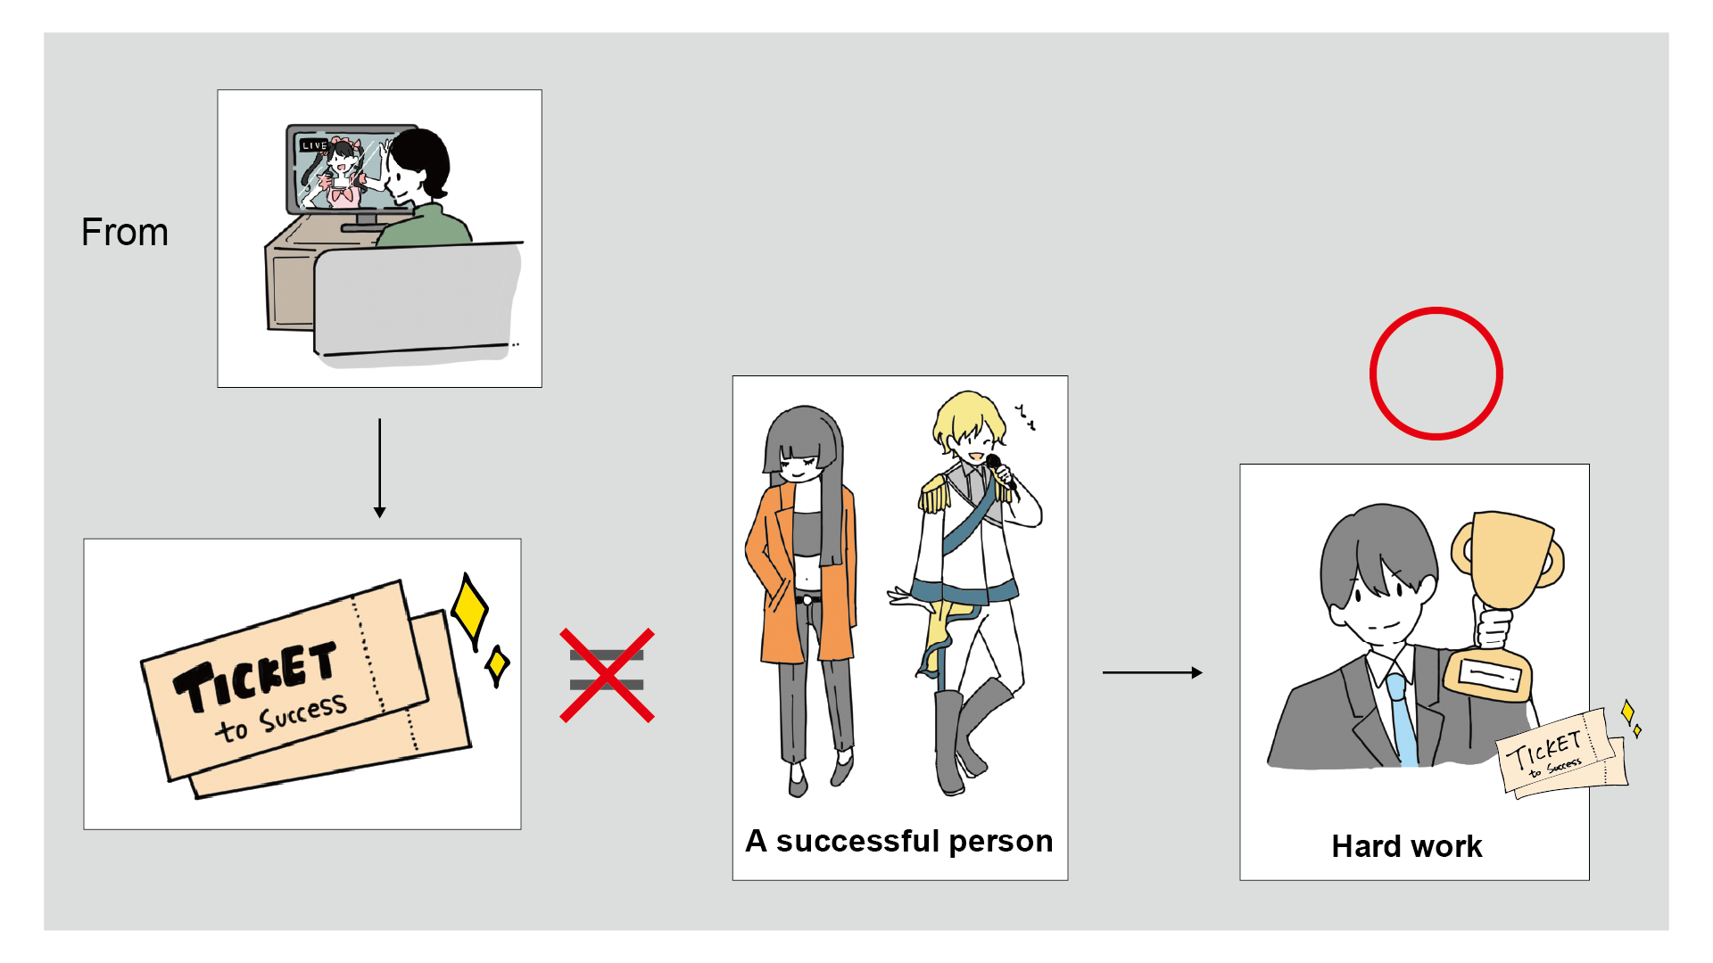

Slide 32
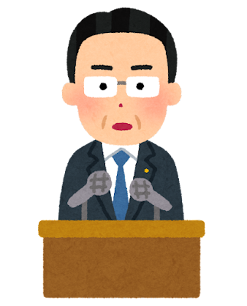
TRY EIYOW! ③
You =
Explain the picture②,
doing EIYOW.

Slide 33
TRY EIYOW! ③
Watch the part of the video(2:01〜2:22).
and practice for 2min!

Slide 34
EIYOW Reproduction
You are easily influenced by TV.
And you might think you don’t have to do hard work to become successful.
And you might think doing rap or playing basketball or being a reality TV star, which means famous people, makes you successful.

Slide 35
12 times!
ＮＯ！
Publishing company
said
to

Slide 36
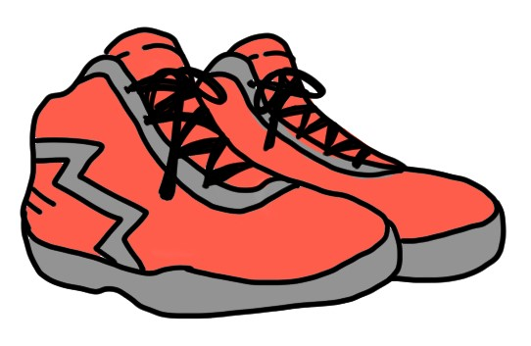
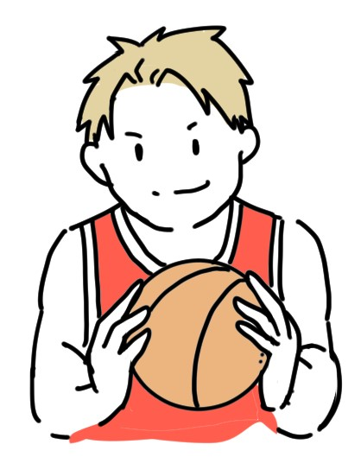
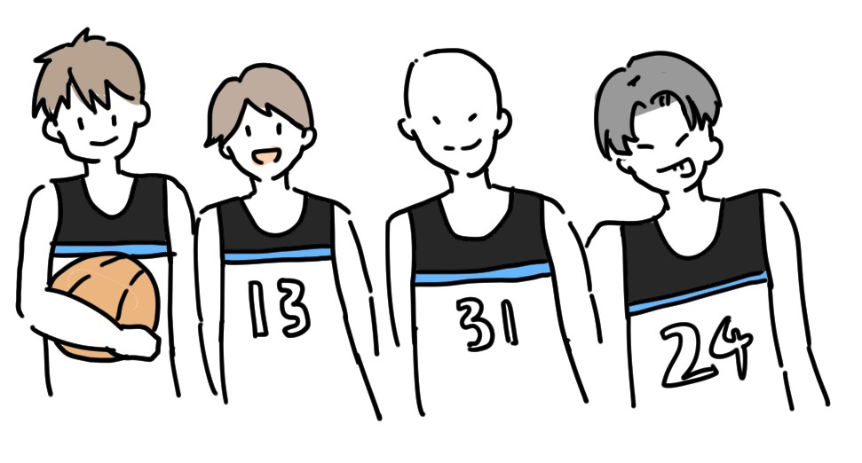

Slide 37
Question!⑤
From examples of and
What do you think is the message this president wants to tell?
share your ideas with your pair.
You have 2min.

Slide 38
Hints for EIYOW
Slide No.50 (EIYOW Expression ②)is the hint for how to do EIYOW.
If you need help, you can use the expression.

Slide 39
Final EIYOW Activity

Slide 40
Quote1 Every single one of you has something that you’re good at. Every single one of you has something to offer. And you have a responsibility to yourself to discover what that is. Quote2 If you get a bad grade, that doesn’t mean you’re stupid, it just means you need to spend more time studying. Quote3 No one’s born being good at all things. You become good at things through hard work.

Slide 41
EIYOW＋tell your original idea
STEP1 Chose one quote from Quote1〜Quote 3 and EIYOW the quote.
STEP2 After EIYOW, tell your opinion about the quote.
・If you agree with the quote, give some positive comments.
・If you don’t agree with the quote, give some negative comments.

Slide 42
You have 4min to prepare.

Slide 43
Share your ideas in a group of 4 (3)
A
B
C
D

Slide 44
Hints for EIYOW
Slide No.51〜52(EIYOW テンプレート)is the hint for how to do EIYOW.
If you need help, you can use the expression.

Slide 45
Tell your EIYOW ＋ your original idea
Student A
EIYOW＋Comments
What do you think?
↓
Student B
EIYOW＋Comments

Slide 46
EIYOW Expression ①
元の英文全体を簡単に言い換えたい場合
・・・ means that 〜. 「・・・は〜という意味です。」
使い方：「元の文 」means that 「EIYOWで簡単な英語にした文」.

Slide 47
EIYOW Expression ②
①相手のEIYOWと似ている場合
例：A: I think Obama wants to tell that EIYOW. What
do you think?
B: I think so too. I think Obama wants to tell that
EIYOW.
②相手のEIYOWと違う場合
例：A: I think Obama wants to tell that EIYOW. What do
you think?
B: I see. I have a different idea. I think Obama wants
to tell that EIYOW.

Slide 48
EIYOW テンプレート レベル1
I chose the quote 1 ・ 2 ・ 3.
It means that 〜.
↓
quoteに賛成の場合：I agree. / I think so.
/ I like this idea.
quoteに否定の場合: I disagree. / I don’t think so.
/ I’m not sure.
＋選んだコメントを相手に伝える

Slide 49
EIYOW テンプレート レベル2
I chose the quote 1 ・ 2 ・3.
It means that〜.
↓
Some people might say～.
But, I have a different idea.
＋自分のオリジナルの意見

Slide 50
Last Question from Us
What do you think is the most important message this president wants to tell?
You have 1min and a half
to prepare.
Share your ideas with your pair.

Slide 51
Wrap up today’s lesson!
WRAP IT UP!

Slide 52
Why EIYOW?
①英語を理解する 和訳する
②英語を理解する 自分の用いる語彙・表現で学んだ内容を表現できる(EIYOW)

Slide 53
Two types of EIYOW
①分解パターン(Decomposing)
例：School
It is a place. For example, You study, do Bukatsu or talk with your friends there.
②シンプルパターン(Simplifying)
例：gastroenteritis
It is sickness. You feel strong stomachache.

Slide 54
Make us all proud!! （自分達に誇りを持とう！）
緊張と集中の100分
お疲れ様でした！！！

